Slide 1
The Christian Life
Jesus’ Creed

Slide 2
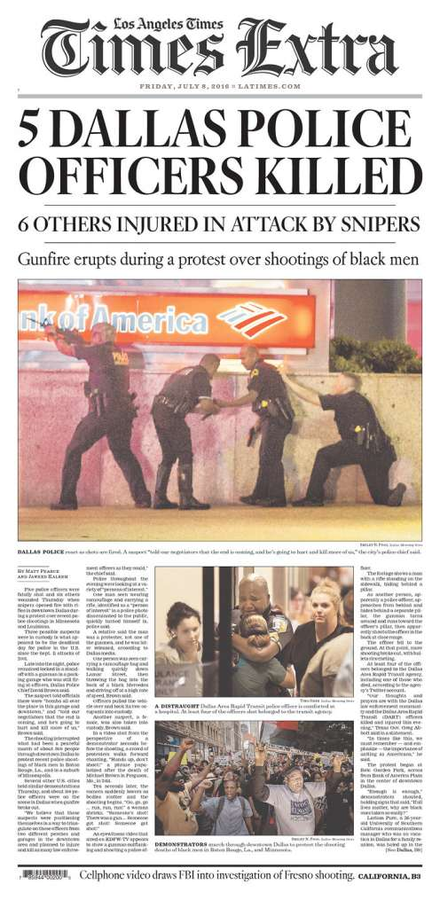

Slide 3
²⁵ On one occasion an expert in the law stood up to test Jesus. “Teacher,” he asked, “what must I do to inherit eternal life?”
²⁶ “What is written in the Law?” he replied. “How do you read it?”

Slide 4
²⁷ He answered, “‘Love the Lord your God with all your heart and with all your soul and with all your strength and with all your mind’; and, ‘Love your neighbor as yourself.’”
²⁸ “You have answered correctly,” Jesus replied. “Do this and you will live.”
Luke 10:25-28

Slide 5
Every day seek to live out the Jesus Creed to love God and love others.

Slide 6
  A crucial question
  A correct answer
  An important clarification

Slide 7
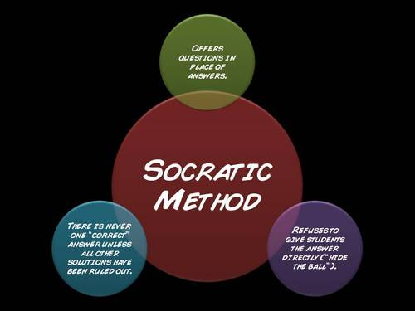

Slide 8
²⁵ On one occasion an expert in the law stood up to test Jesus. “Teacher,” he asked, “what must I do to inherit eternal life?”
²⁶ “What is written in the Law?” he replied. “How do you read it?”

Slide 9


Slide 10
  A crucial question
  A correct answer
  An important clarification

Slide 11
²⁷ He answered, “‘Love the Lord your God with all your heart and with all your soul and with all your strength and with all your mind’; and, ‘Love your neighbor as yourself.’”
²⁸ “You have answered correctly,” Jesus replied. “Do this and you will live.”
Luke 10:25-28

Slide 12
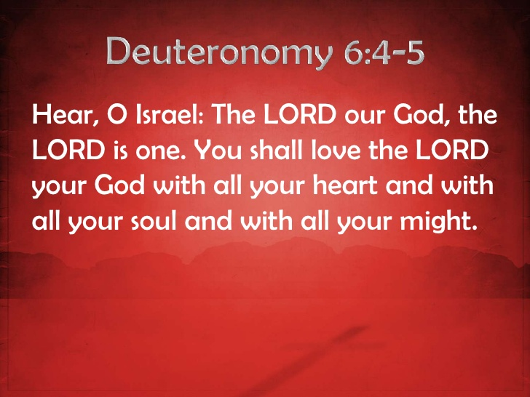

Slide 13
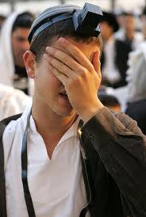

Slide 14
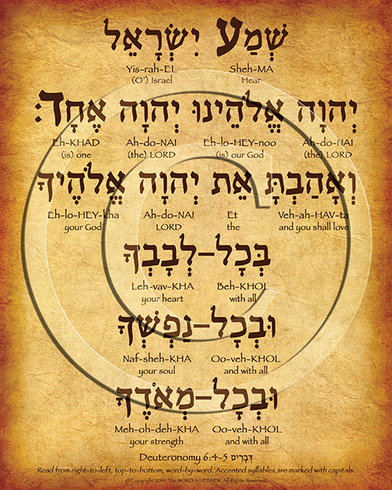

Slide 15
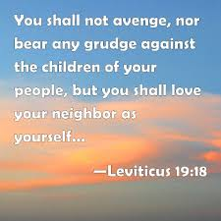

Slide 16
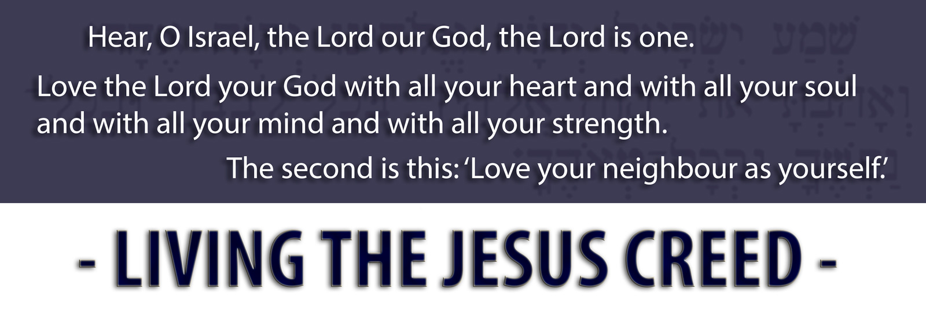

Slide 17
  A crucial question
  A correct answer
  An important clarification

Slide 18


Slide 19
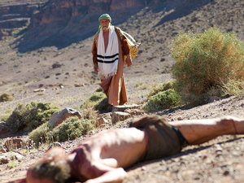

Slide 20
³⁶ “Which of these three do you think was a neighbor to the man who fell into the hands of robbers?”
³⁷ The expert in the law replied, “The one who had mercy on him.”
Jesus told him, “Go and do likewise.”

Slide 21


Slide 22
Lessons for Disciples

Slide 23
Every day seek to live out the Jesus Creed to love God and love others.

Slide 24
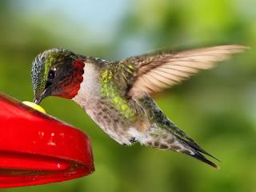

Slide 25
‘Hear, O Israel: The Lord our God, the Lord is one. ³⁰ Love the Lord your God with all your heart and with all your soul and with all your mind and with all your strength.’ ³¹ The second is this: ‘Love your neighbor as yourself.’ There is no commandment greater than these.”
Mark 12:29-31 NIV

