Slide 1
Lent
Repent or Perish

Slide 2
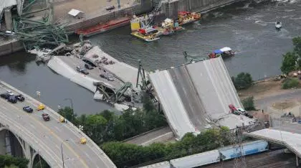

Slide 3
¹ Now there were some present at that time who told Jesus about the Galileans whose blood Pilate had mixed with their sacrifices. ² Jesus answered, “Do you think that these Galileans were worse sinners than all the other Galileans because they suffered this way? ³ I tell you, no! But unless you repent, you too will all perish.

Slide 4
⁴ Or those eighteen who died when the tower in Siloam fell on them—do you think they were more guilty than all the others living in Jerusalem? ⁵ I tell you, no! But unless you repent, you too will all perish.”

Slide 5
⁶ Then he told this parable: “A man had a fig tree growing in his vineyard, and he went to look for fruit on it but did not find any. ⁷ So he said to the man who took care of the vineyard, ‘For three years now I’ve been coming to look for fruit on this fig tree and haven’t found any. Cut it down! Why should it use up the soil?’

Slide 6
⁸ “‘Sir,’ the man replied, ‘leave it alone for one more year, and I’ll dig around it and fertilize it. ⁹ If it bears fruit next year, fine! If not, then cut it down.’”
1 Corinthians 13:1-9

Slide 7
Tragic Circumstances

Slide 8
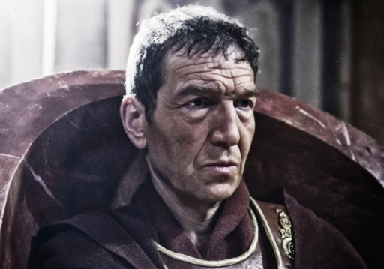

Slide 9
¹ Now there were some present at that time who told Jesus about the Galileans whose blood Pilate had mixed with their sacrifices. ² Jesus answered, “Do you think that these Galileans were worse sinners than all the other Galileans because they suffered this way? ³ I tell you, no! But unless you repent, you too will all perish.

Slide 10
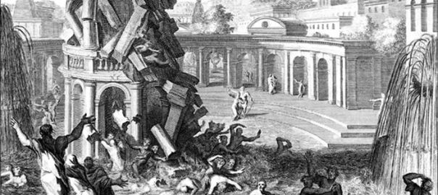

Slide 11
⁴ Or those eighteen who died when the tower in Siloam fell on them—do you think they were more guilty than all the others living in Jerusalem? ⁵ I tell you, no! But unless you repent, you too will all perish.”

Slide 12
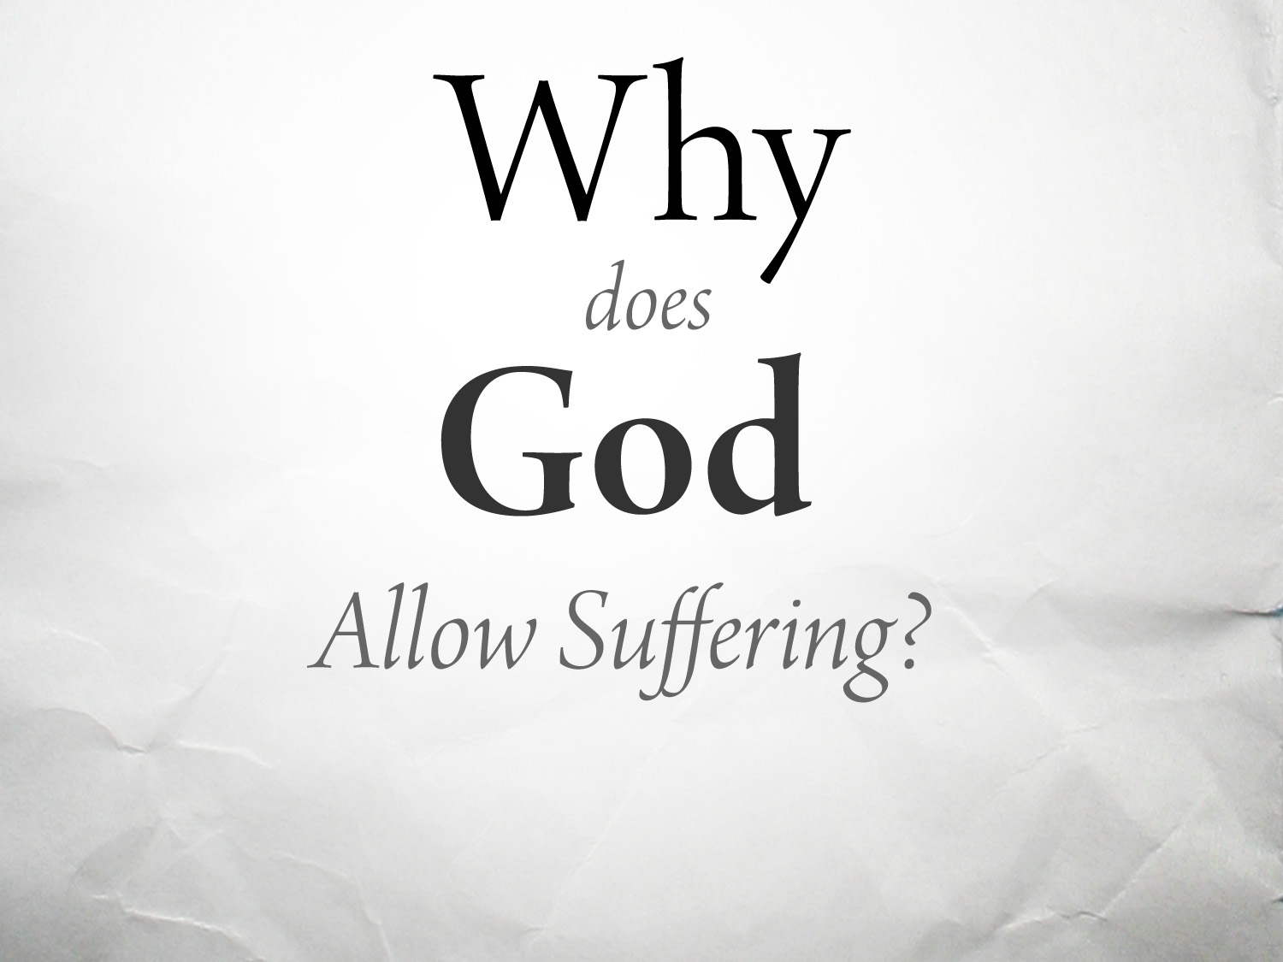

Slide 13
Jesus implies that the victims did nothing wrong, nothing that caused their demise. . .
Although these events might allow Jesus an opportunity to defend God against charges of mismanaging the universe, he does not go that route. Jesus only implies that we must not equate tragedy with divine punishment. Sin does not make atrocities come. They just come.
Dr. Matt Skinner
Luther Seminary

Slide 14
Life's fragility gives it urgency.
Dr. Matt Skinner

Slide 15
A Call to Repent

Slide 16
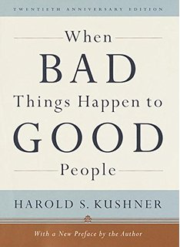

Slide 17
² Jesus answered, “Do you think that these Galileans were worse sinners than all the other Galileans because they suffered this way? ³ I tell you, no! But unless you repent, you too will all perish.

Slide 18
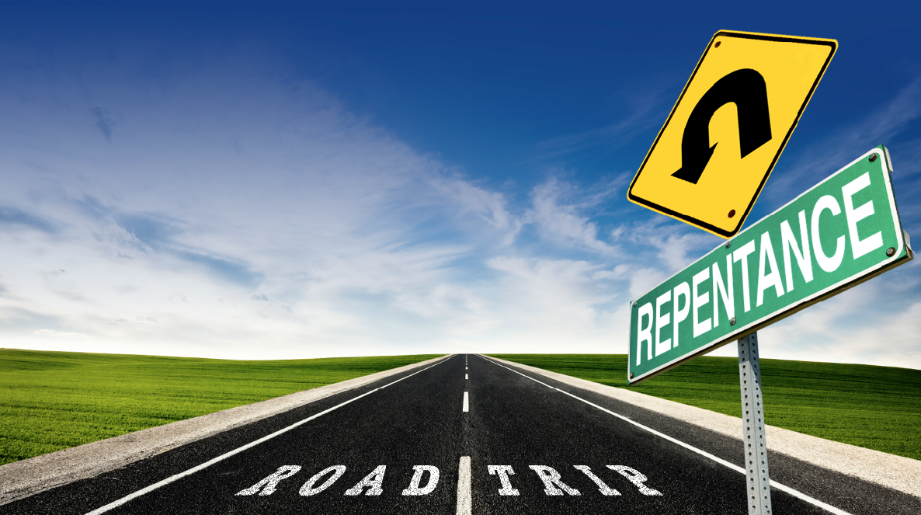

Slide 20
A Temporary Reprieve

Slide 21
Reprieve:
To provide temporary or permanent relief from punishment

Slide 22
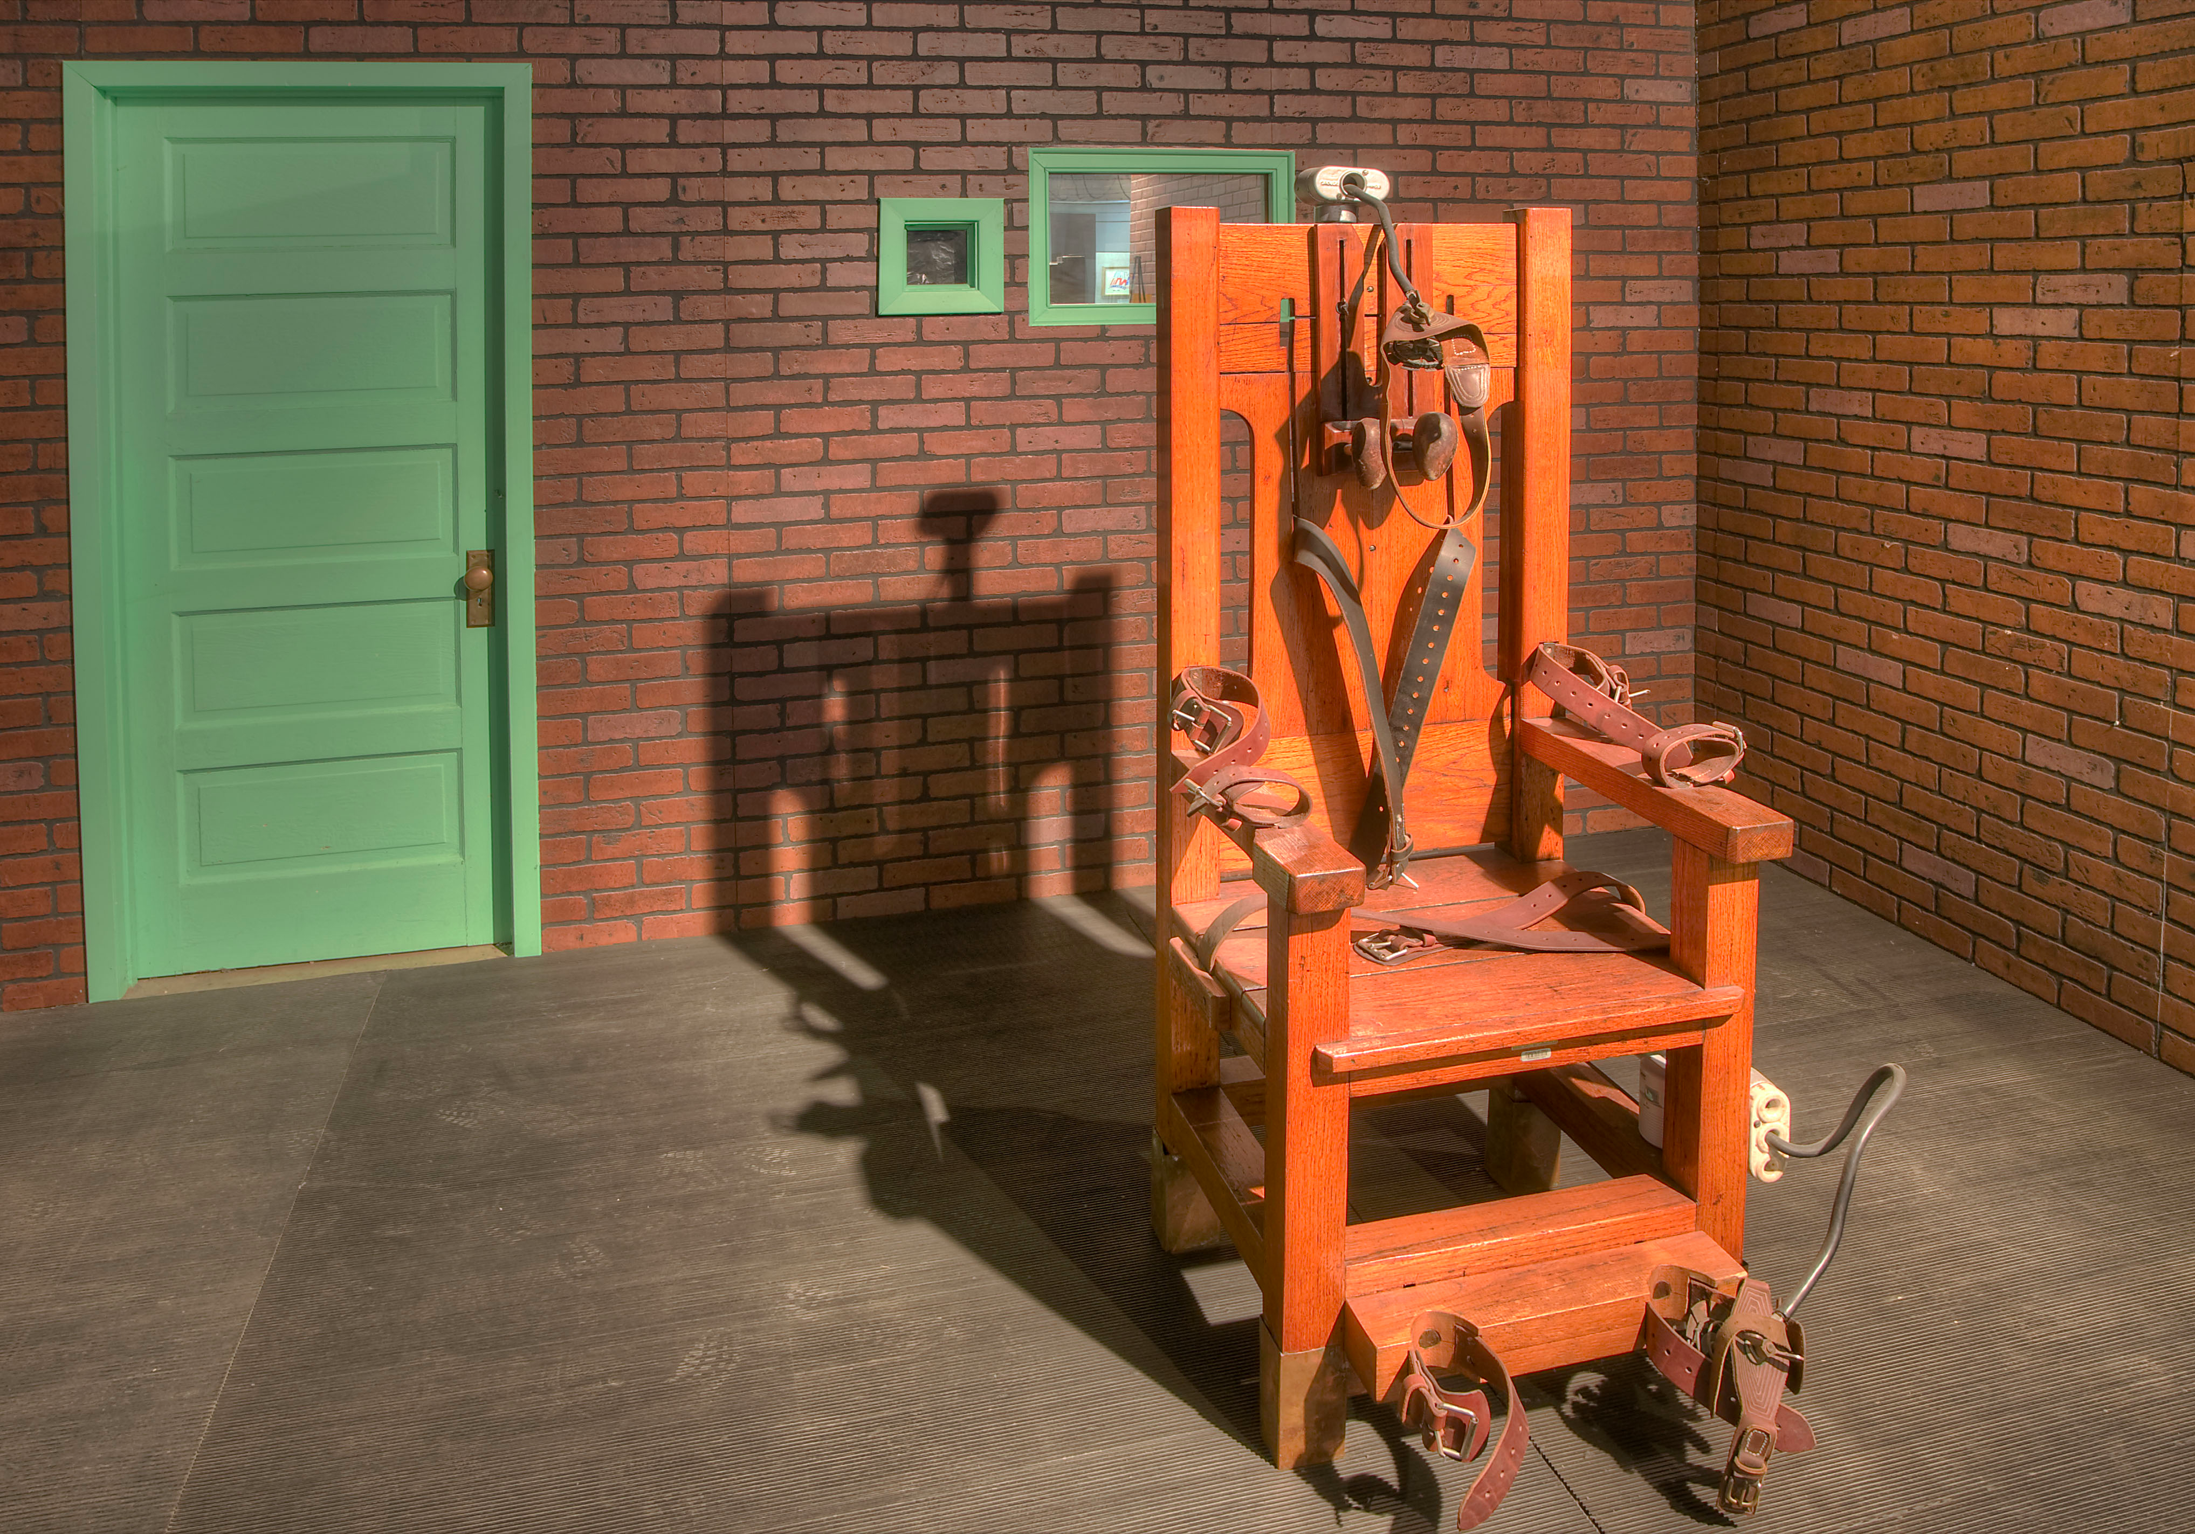

Slide 23
⁶ Then he told this parable: “A man had a fig tree growing in his vineyard, and he went to look for fruit on it but did not find any. ⁷ So he said to the man who took care of the vineyard, ‘For three years now I’ve been coming to look for fruit on this fig tree and haven’t found any. Cut it down! Why should it use up the soil?’

Slide 24
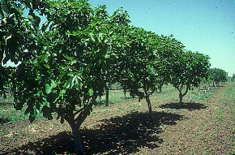

Slide 25
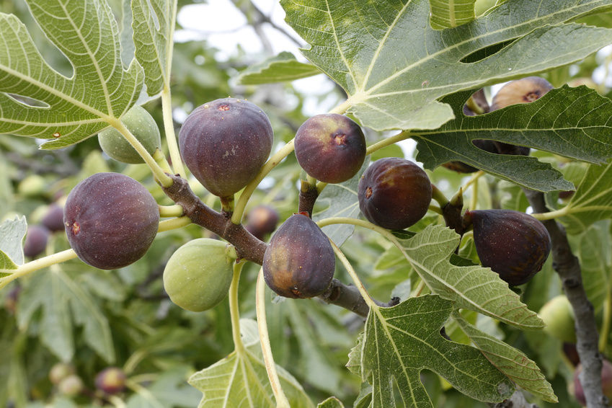

Slide 26
⁸ “‘Sir,’ the man replied, ‘leave it alone for one more year, and I’ll dig around it and fertilize it. ⁹ If it bears fruit next year, fine! If not, then cut it down.’”

Slide 27
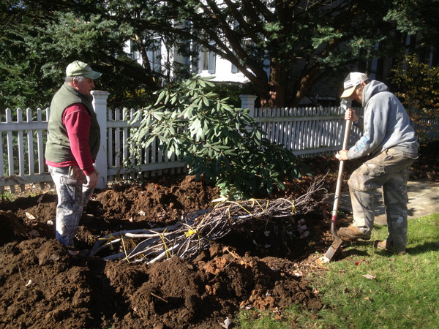

Slide 29
Apply to Our Lives

Slide 31
