Slide 1
Renew
Your Perception

Slide 4
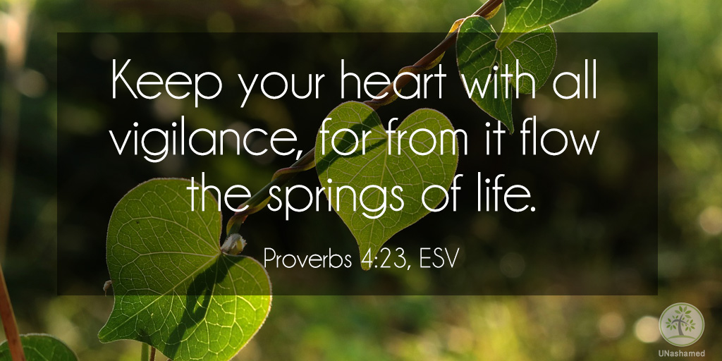

Slide 6
² Consider it pure joy, my brothers and sisters, whenever you face trials of many kinds, ³ because you know that the testing of your faith produces perseverance. ⁴ Let perseverance finish its work so that you may be mature and complete, not lacking anything.
James 1:2-4 NIV

Slide 7
Context

Slide 8
James, a servant of God and of the Lord Jesus Christ,
To the twelve tribes scattered among the nations:
Greetings.
James 1:1

Slide 9
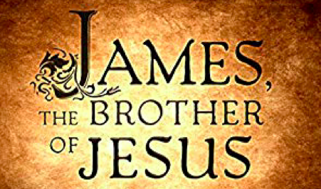

Slide 10
Reality of trials. . .

Slide 11
² Consider it pure joy, my brothers and sisters, whenever you face trials of many kinds. . .

Slide 13
One of the most difficult parts of the Christian life is the fact that becoming a disciple of Christ does not make us immune to life’s trials and tribulations. Why would a good and loving God allow us to go through such things as the death of a child, disease and injury to ourselves and our loved ones, financial hardships, worry and fear? Surely, if He loved us, He would take all these things away from us. After all, doesn’t loving us mean He wants our lives to be easy and comfortable? Well, no, it doesn’t.
Got Questions.org

Slide 14
Family relationships
Disappointments in love
Disappointments in friendships
Academic or career disappointments
Health issues
Financial crisis
Existential crisis
Exploring Your Mind

Slide 15
Response to trials. . .

Slide 16
² Consider it pure joy, my brothers and sisters, whenever you face trials of many kinds, ³ because you know that the testing of your faith produces perseverance. ⁴ Let perseverance finish its work so that you may be mature and complete, not lacking anything.
James 1:2-4 NIV

Slide 18
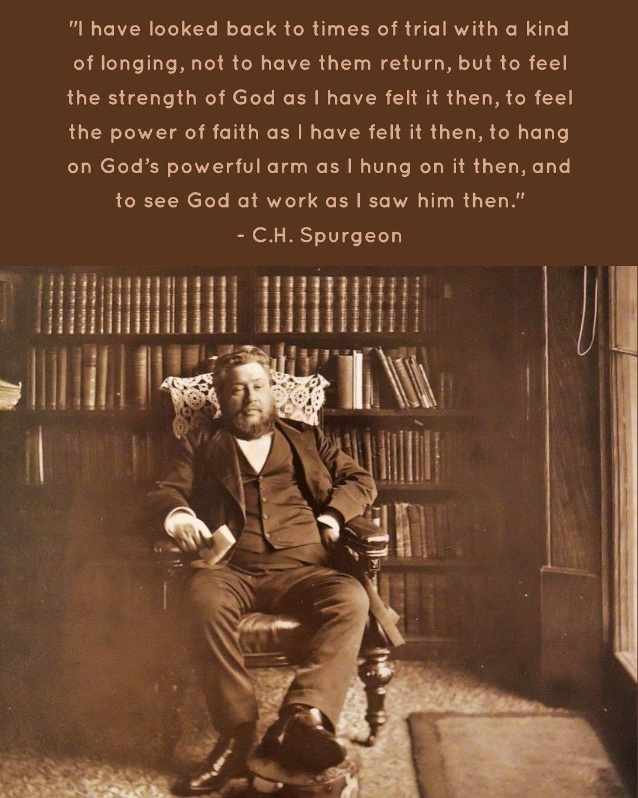

Slide 19
Result of trials. . .

Slide 20
² Consider it pure joy, my brothers and sisters, whenever you face trials of many kinds, ³ because you know that the testing of your faith produces perseverance. ⁴ Let perseverance finish its work so that you may be mature and complete, not lacking anything.

Slide 21
Testing – genuineness & creative
Perseverance – endure patiently, actively
Maturity – sanctified, becoming Christlike

Slide 22
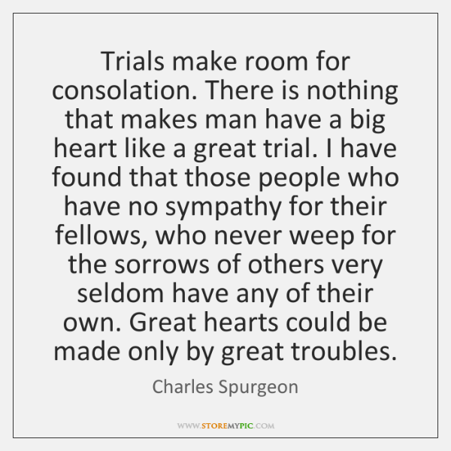

Slide 23
Live it Out

Slide 24
Respond to trials with an attitude of joy

