Slide 1
Forgiven
Psalm 32

Slide 2
Of David. A maskil.
¹ Blessed is the one whose transgressions are forgiven, whose sins are covered. ² Blessed is the one whose sin the LORD does not count against them and in whose spirit is no deceit.

Slide 3
³ When I kept silent, my bones wasted away through my groaning all day long. ⁴ For day and night your hand was heavy on me; my strength was sapped as in the heat of summer.

Slide 4
⁵ Then I acknowledged my sin to you and did not cover up my iniquity. I said, “I will confess my transgressions to the LORD.” And you forgave the guilt of my sin.

Slide 5
⁶ Therefore let all the faithful pray to you while you may be found; surely the rising of the mighty waters will not reach them. ⁷ You are my hiding place; you will protect me from trouble and surround me with songs of deliverance.

Slide 6
⁸ I will instruct you and teach you in the way you should go; I will counsel you with my loving eye on you. ⁹ Do not be like the horse or the mule, which have no understanding but must be controlled by bit and bridle or they will not come to you. ¹⁰ Many are the woes of the wicked, but the LORD’s unfailing love surrounds the one who trusts in him.

Slide 7
¹¹ Rejoice in the LORD and be glad, you righteous; sing, all you who are upright in heart!

Slide 8
Celebration of Forgiveness
¹ Blessed is the one whose transgressions are forgiven, whose sins are covered. ² Blessed is the one whose sin the LORD does not count against them and in whose spirit is no deceit.

Slide 9
Consequences of Unconfessed Sin
³ When I kept silent, my bones wasted away through my groaning all day long. ⁴ For day and night your hand was heavy on me; my strength was sapped as in the heat of summer.

Slide 10
Confession of Sin
⁵ Then I acknowledged my sin to you and did not cover up my iniquity. I said, “I will confess my transgressions to the LORD.” And you forgave the guilt of my sin.

Slide 11
Counsel of a Sinner
⁸ I will instruct you and teach you in the way you should go; I will counsel you with my loving eye on you. ⁹ Do not be like the horse or the mule, which have no understanding but must be controlled by bit and bridle or they will not come to you. ¹⁰ Many are the woes of the wicked, but the LORD’s unfailing love surrounds the one who trusts in him.

Slide 12
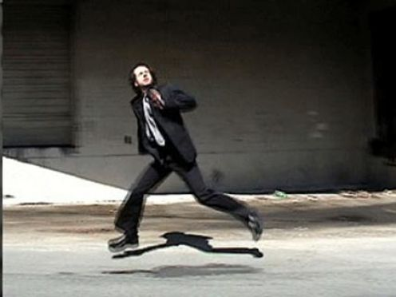
Man Running from God

Slide 13
Conclusion
¹¹ Rejoice in the LORD and be glad, you righteous; sing, all you who are upright in heart!

