Slide 1
Lent
Prayer

Slide 2


Slide 3


Slide 4
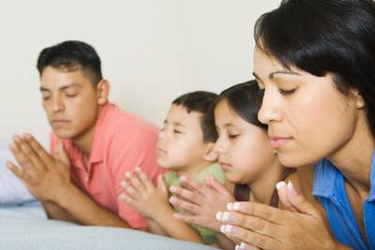

Slide 5
Seek to become a person of prayer.

Slide 6
² Devote yourselves to prayer, being watchful and thankful. ³ And pray for us, too, that God may open a door for our message, so that we may proclaim the mystery of Christ, for which I am in chains. ⁴ Pray that I may proclaim it clearly, as I should.
Colossians 4:2-4

Slide 7
² Devote yourselves to prayer, being watchful and thankful.

Slide 8


Slide 9
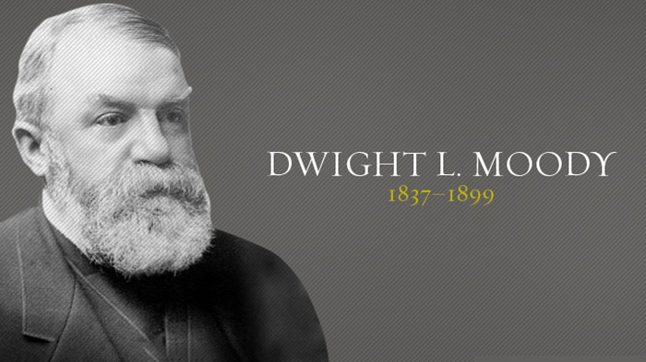

Slide 10
Q. 98. What is prayer?
Prayer is an offering up of our desires to God, for things agreeable to his will, in the name of Christ, with confession of our sins and thankful acknowledgement of his mercies.
The Westminster Shorter Catechism
in modern English with Scripture proofs and comments

Slide 11
² Devote yourselves to prayer, being watchful and thankful.

Slide 12
Wholly giving yourself, your time, or your energy to something. Spending all or most of your time or energy on said passion.

Slide 13
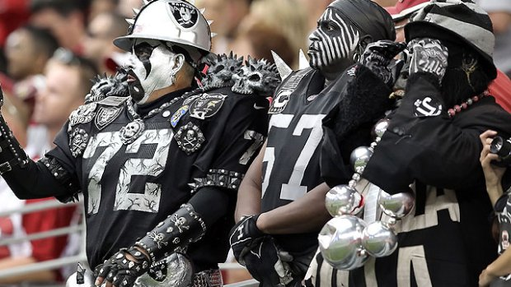

Slide 14


Slide 15


Slide 16
² Devote yourselves to prayer, being watchful and thankful.

Slide 17
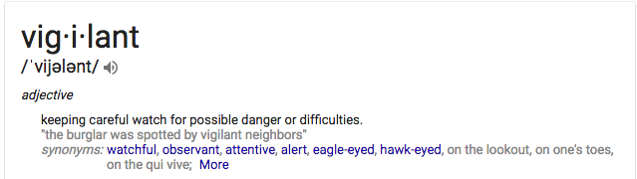

Slide 18
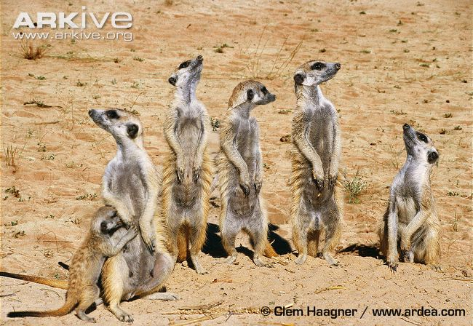

Slide 19


Slide 20
Praying. . .

Slide 21
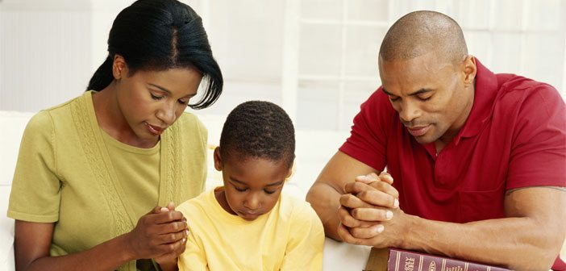

Slide 22
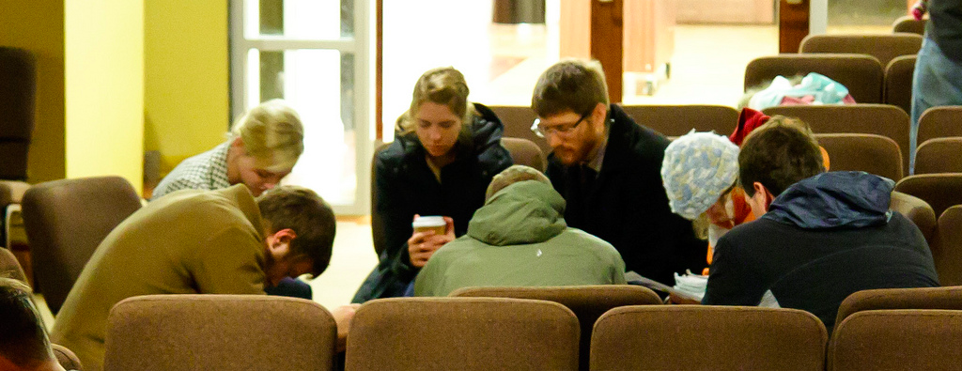

Slide 23
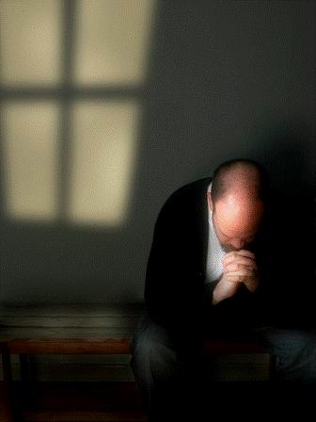

Slide 24
³ And pray for us, too, that God may open a door for our message, so that we may proclaim the mystery of Christ, for which I am in chains. ⁴ Pray that I may proclaim it clearly, as I should.

Slide 25



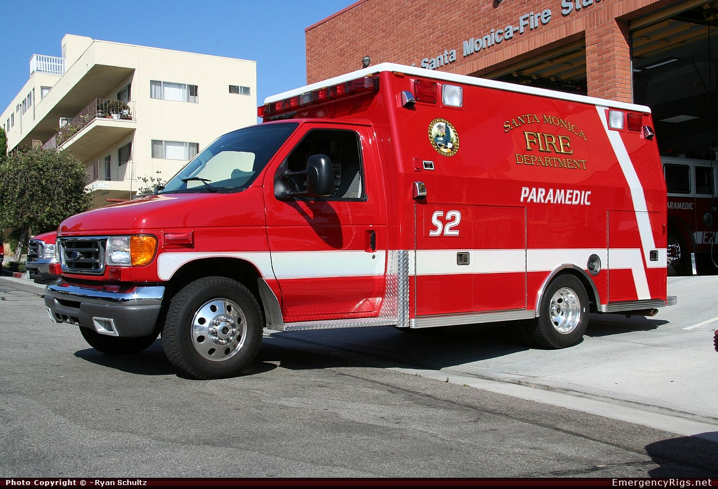

Slide 26


