Slide 1
Romans
His Kindness

Slide 2
Spiritual Growth Progression

Slide 3
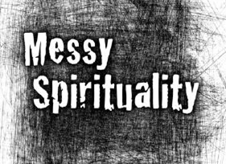

Slide 4
Messy Spirituality is the scandalous assertion that following Christ is anything but tidy and neat, balanced and orderly. Far from it. Spirituality is complex, complicated, and perplexing. Spirituality is anything but a straight line.
Mike Yaconelli

Slide 5
Or do you show contempt for the riches of his kindness, forbearance and patience, not realizing that God’s kindness is intended to lead you to repentance?
Romans 2:4 NIV

Slide 6
Kindness
Forbearance
Patience

Slide 7
Contempt
Compromise
Change

Slide 8
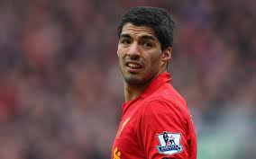

Slide 9
Contempt
Compromise
Change

Slide 10
Respond to God’s kindness by turning from our sin.

Slide 11
Let us throw off everything that hinders and the sin that so easily entangles.
Hebrews 12:1

Slide 13
Pray
Plan

