Slide 1
Church
Healthy Characteristics: Prayer

Slide 2
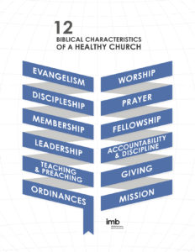

Slide 3
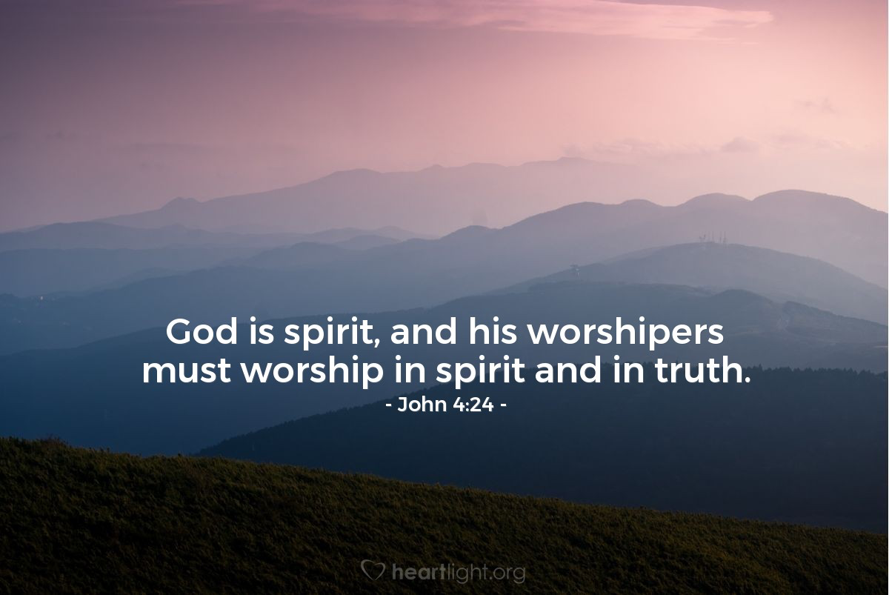

Slide 5
Biblical Prayer

Slide 6
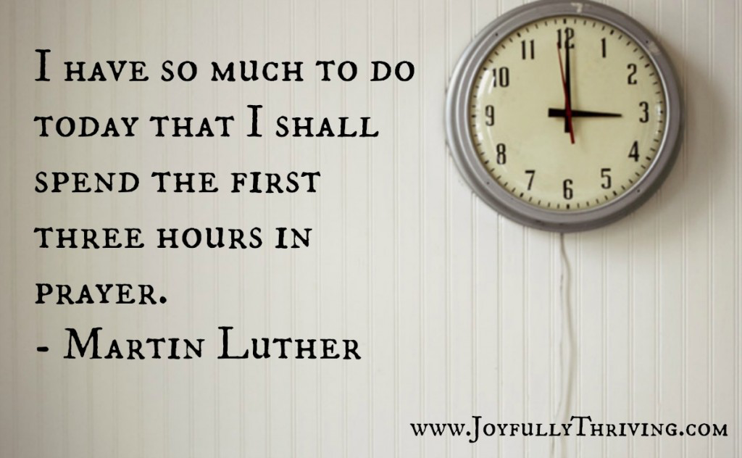

Slide 7
They devoted themselves to the apostles’ teaching and to fellowship, to the breaking of bread and to prayer.
Acts 2:42

Slide 8
Private prayer is essential but insufficient. A healthy church not only prays but prays with one another.
International Missions Board

Slide 9
They devoted themselves to the apostles’ teaching and to fellowship, to the breaking of bread and to prayer.
Acts 2:42

Slide 10
Devote – show steadfast strength, prevailing strength – to consistently showing strength which prevails (in spite of difficulties); to endure (remain firm), staying in a fixed direction.

Slide 12
They devoted themselves to the apostles’ teaching and to fellowship, to the breaking of bread and to prayer.
Acts 2:42

Slide 13
Five Reasons to Pray with Others
Sharon Gamble

Slide 14
Focus

Slide 15
Presence

Slide 16
Insight

Slide 17
Obedience

Slide 18
Community

Slide 19
Lessons for Disciples

Slide 20
Pray with the Church

Slide 21
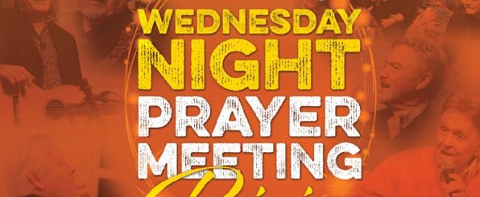

Slide 22
Pray with the Church
Pray with your fellowship

Slide 23
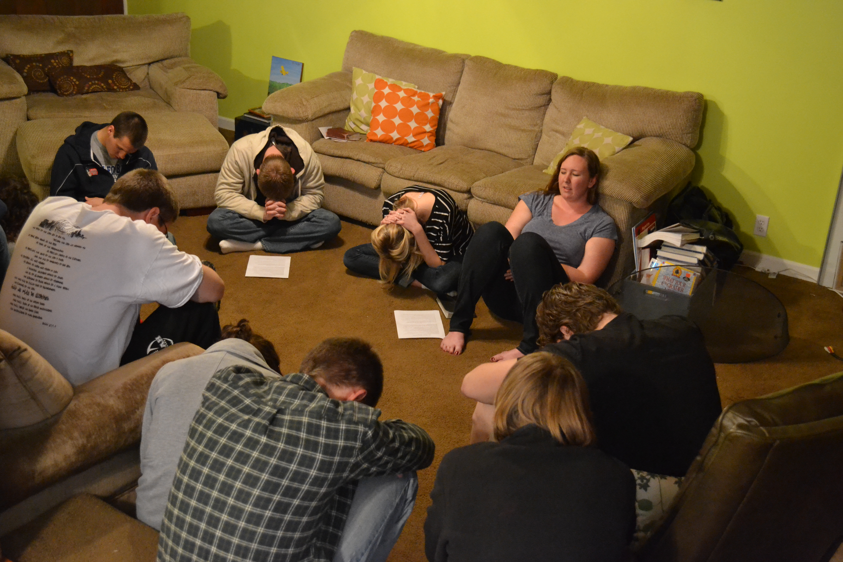

Slide 24
Pray with the Church
Pray with your fellowship
Pray with friends

Slide 25
