Slide 1
Church
Healthy Characteristics

Slide 2
National Community Church

Slide 4
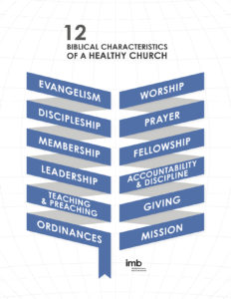

Slide 5
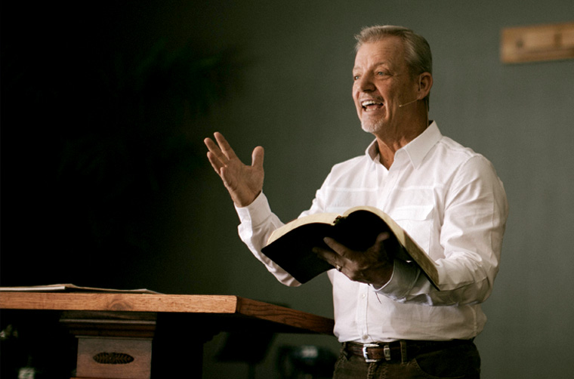

Slide 6
Biblical Leadership

Slide 8
⁵ The reason I left you in Crete was that you might put in order what was left unfinished and appoint elders in every town, as I directed you.
Titus 1

Slide 10
⁶ An elder must be blameless, faithful to his wife, a man whose children believe and are not open to the charge of being wild and disobedient. ⁷ Since an overseer manages God’s household, he must be blameless—not overbearing, not quick-tempered, not given to drunkenness, not violent, not pursuing dishonest gain. ⁸ Rather, he must be hospitable, one who loves what is good, who is self-controlled, upright, holy and disciplined.

Slide 12
⁹ He must hold firmly to the trustworthy message as it has been taught, so that he can encourage others by sound doctrine and refute those who oppose it.

Slide 14
⁹ He must hold firmly to the trustworthy message as it has been taught, so that he can encourage others by sound doctrine and refute those who oppose it.

Slide 15
Biblical Teaching & Preaching

Slide 16
¹⁶ All Scripture is God-breathed and is useful for teaching, rebuking, correcting and training in righteousness, ¹⁷ so that the servant of God may be thoroughly equipped for every good work.
2 Timothy 3:16

Slide 18
¹⁶ All Scripture is God-breathed and is useful for teaching, rebuking, correcting and training in righteousness, ¹⁷ so that the servant of God may be thoroughly equipped for every good work.
2 Timothy 3:16

Slide 19
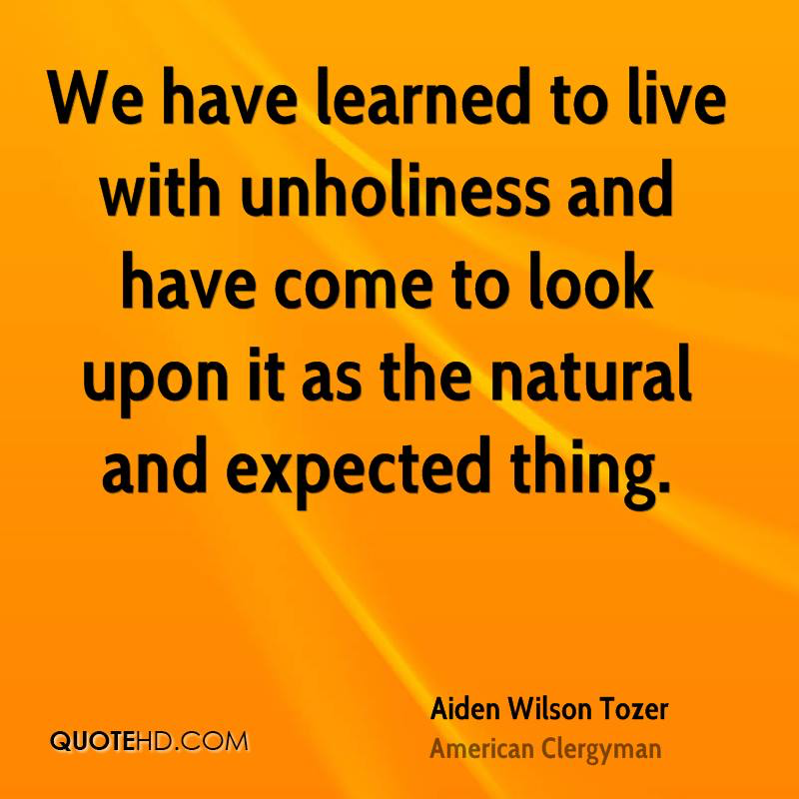

Slide 20
¹⁶ All Scripture is God-breathed and is useful for teaching, rebuking, correcting and training in righteousness, ¹⁷ so that the servant of God may be thoroughly equipped for every good work.
2 Timothy 3:16

Slide 22
Lessons for Disciples

Slide 23
Pray for C4’s Elder Nomination Process

Slide 24
Pray for C4’s Elder Nomination Process
Progress in your knowledge of the Word

Slide 25
Pray for C4’s Elder Nomination Process
Progress in your knowledge of the Word
Pursue a life of holiness

