Slide 5
Building Three Levels of Family Altar

Slide 6
1) Setting Life Example: First Priority

Slide 7
1) Setting Life Example: First Priority

Slide 8
1) Setting Life Example: First Priority

Slide 9
1) Setting Life Example: First Priority

Slide 10
Building Altar

Slide 11
Why Building Altar？

Slide 12
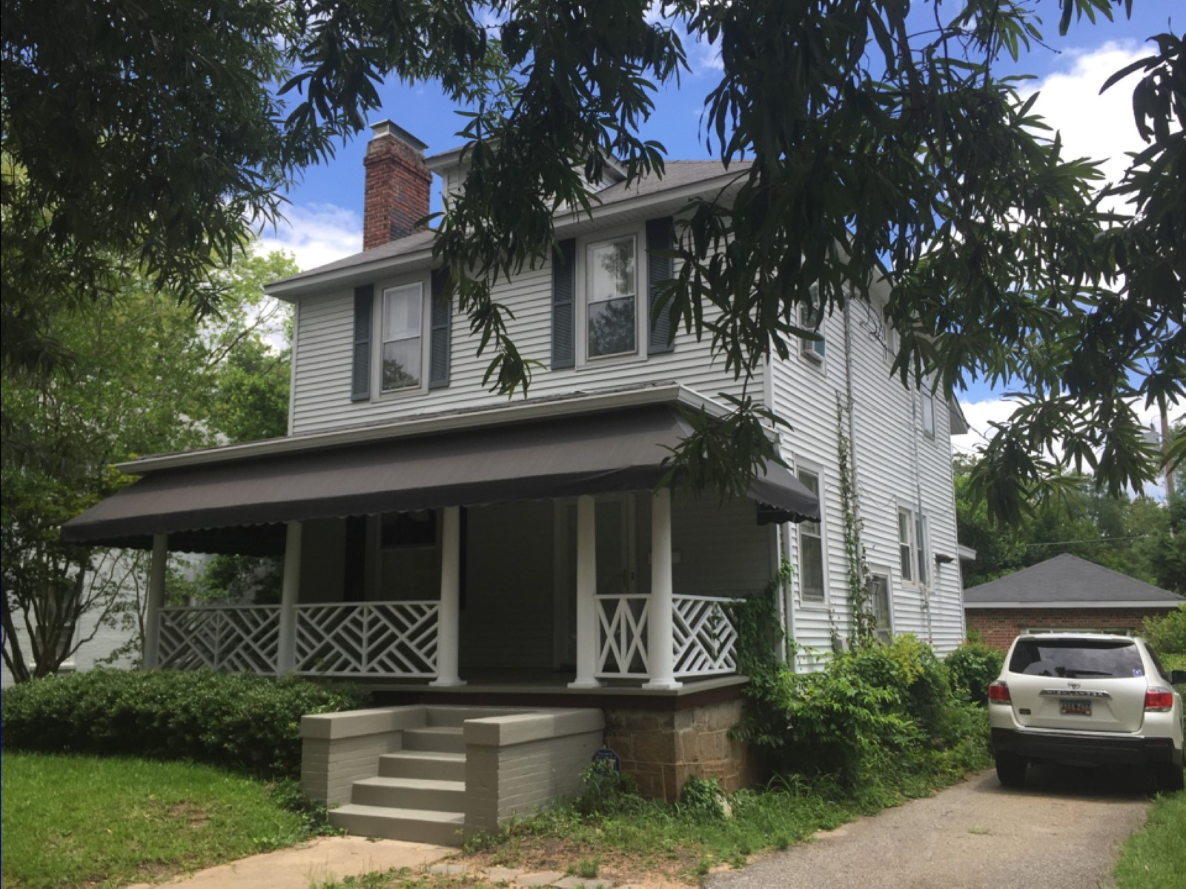

Slide 14
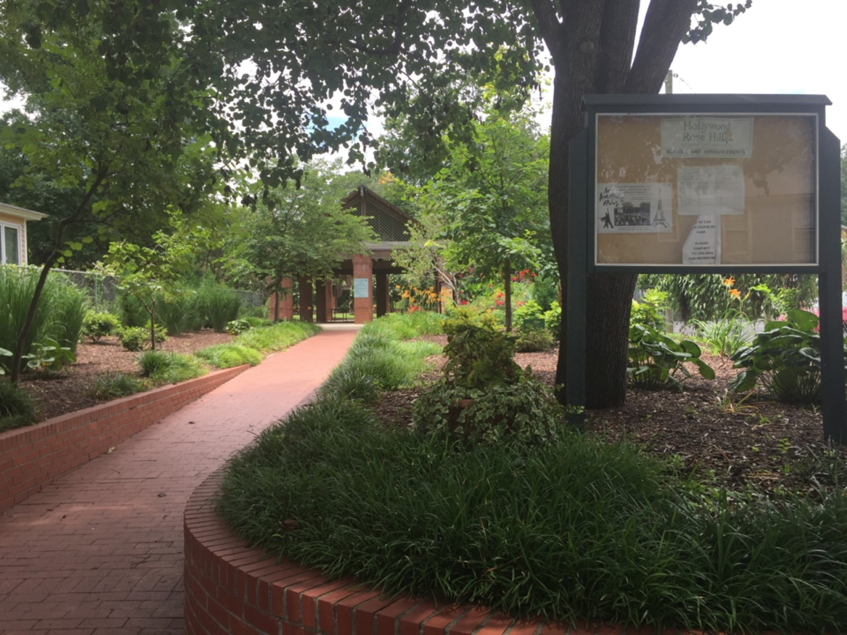

Slide 15
Building Three Levels of Family Altar

Slide 16
2) Establishing Family Worship

Slide 17
2) Establishing Family Worship

Slide 18
2) Establishing Family Worship

Slide 19
Building Three Levels of Family Altar

Slide 20
3) Praying for Family Members

Slide 21
3) Praying for Family Members

Slide 22
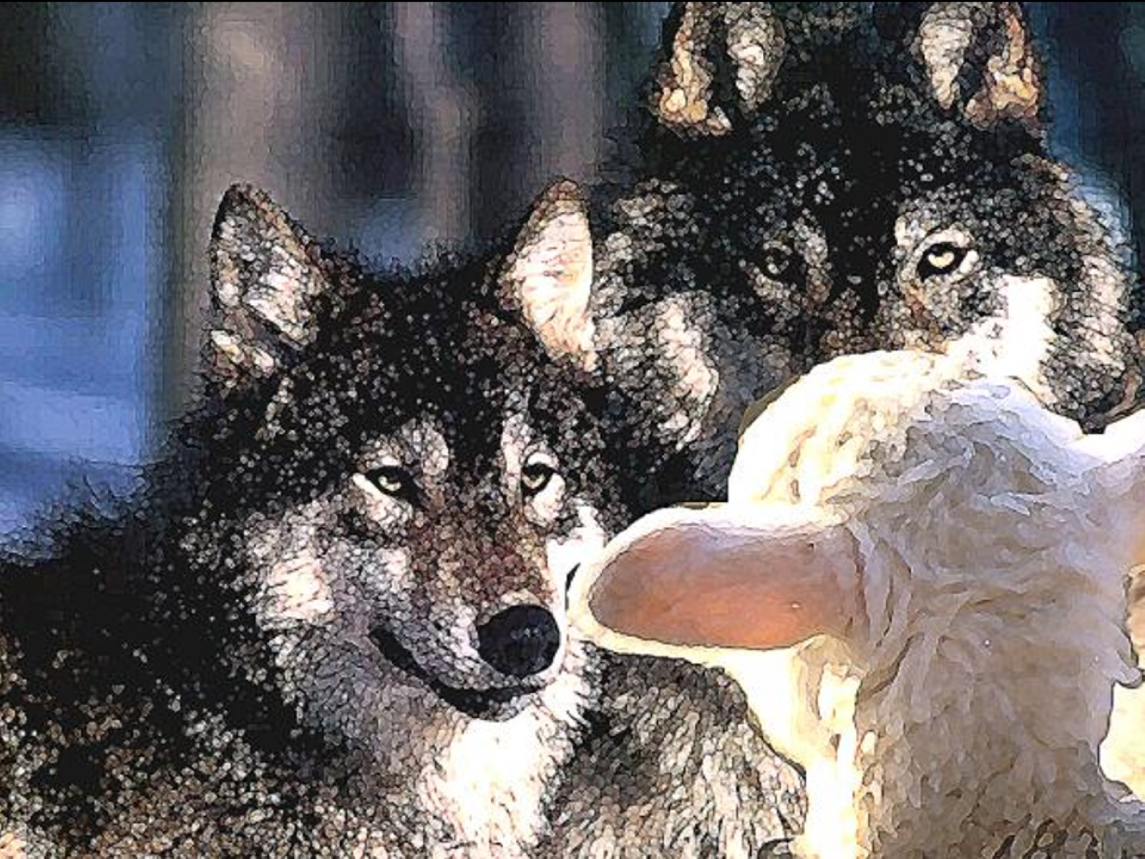

Slide 23
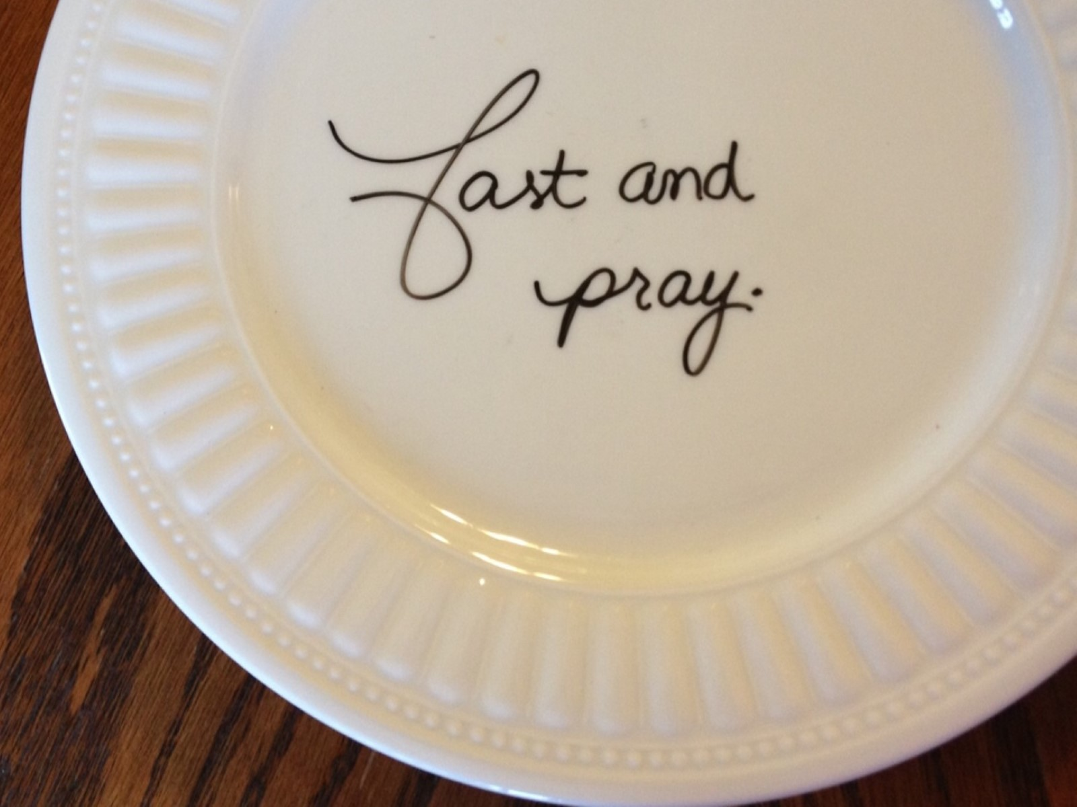

Slide 24
St. Augustine

