Slide 1
Journey to the Cross
Dinner with Jesus

Slide 2


Slide 3
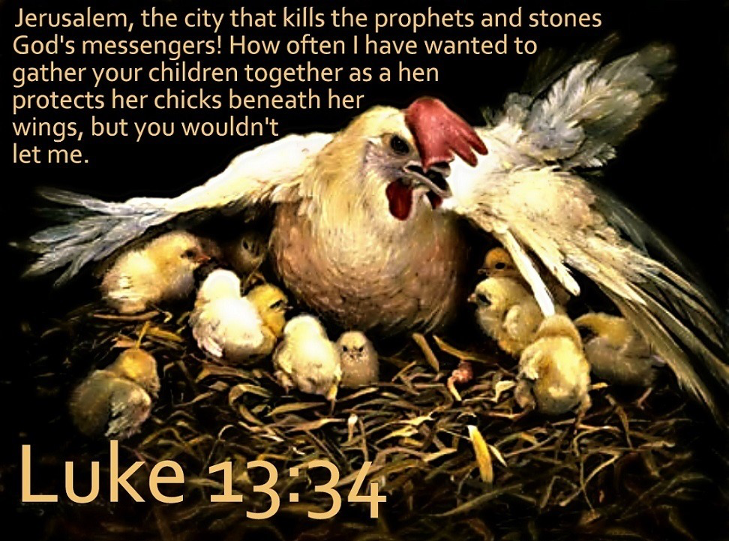

Slide 4
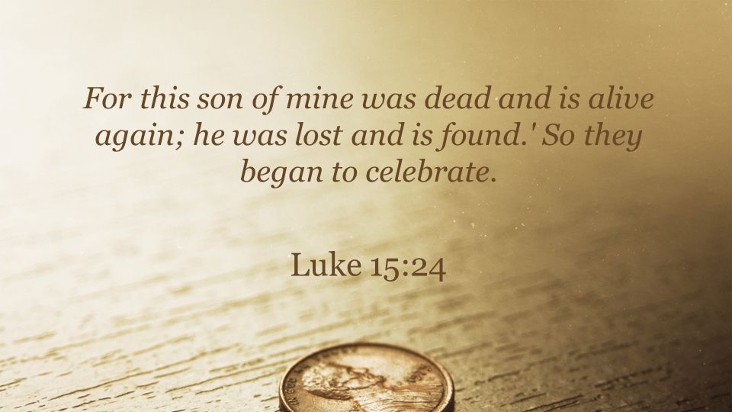

Slide 5
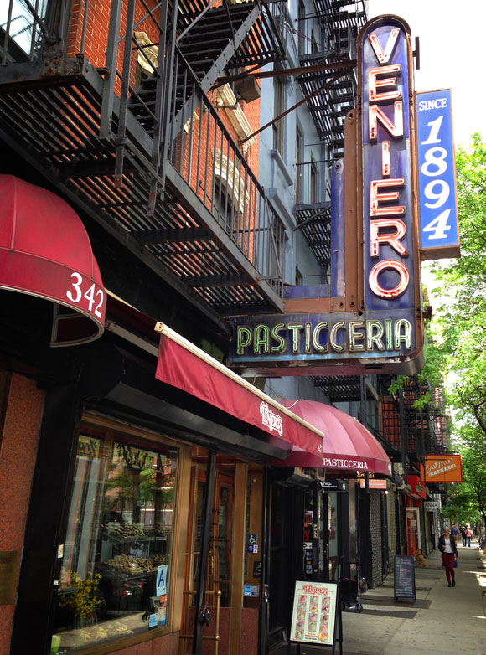

Slide 6
¹ Six days before the Passover, Jesus came to Bethany, where Lazarus lived, whom Jesus had raised from the dead. ² Here a dinner was given in Jesus’ honor. Martha served, while Lazarus was among those reclining at the table with him. ³ Then Mary took about a pint of pure nard, an expensive perfume; she poured it on Jesus’ feet and wiped his feet with her hair. And the house was filled with the fragrance of the perfume.

Slide 7
⁴ But one of his disciples, Judas Iscariot, who was later to betray him, objected, ⁵ “Why wasn’t this perfume sold and the money given to the poor? It was worth a year’s wages.” ⁶ He did not say this because he cared about the poor but because he was a thief; as keeper of the money bag, he used to help himself to what was put into it.

Slide 8
⁷ “Leave her alone,” Jesus replied. “It was intended that she should save this perfume for the day of my burial. ⁸ You will always have the poor among you, but you will not always have me.”
John 12:1-8

Slide 9
Renew our love and adoration for Jesus.

Slide 10
A special dinner

Slide 11


Slide 12
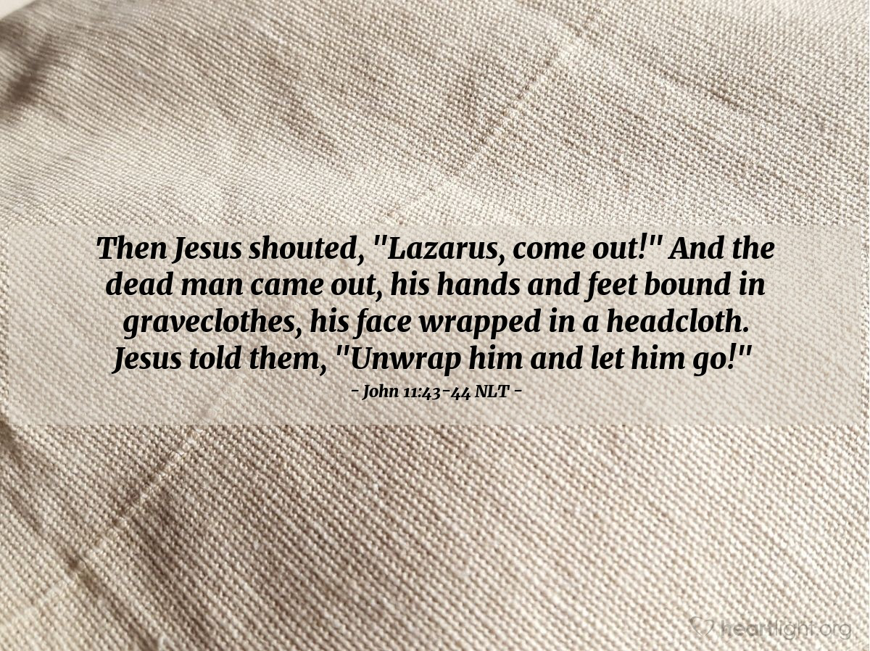

Slide 13
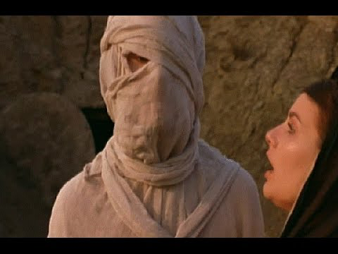

Slide 14
¹ Six days before the Passover, Jesus came to Bethany, where Lazarus lived, whom Jesus had raised from the dead. ² Here a dinner was given in Jesus’ honor. Martha served, while Lazarus was among those reclining at the table with him.

Slide 15
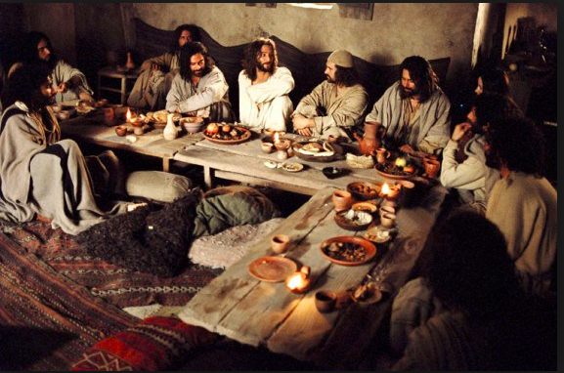

Slide 16
The fragrance of perfume. . .

Slide 17
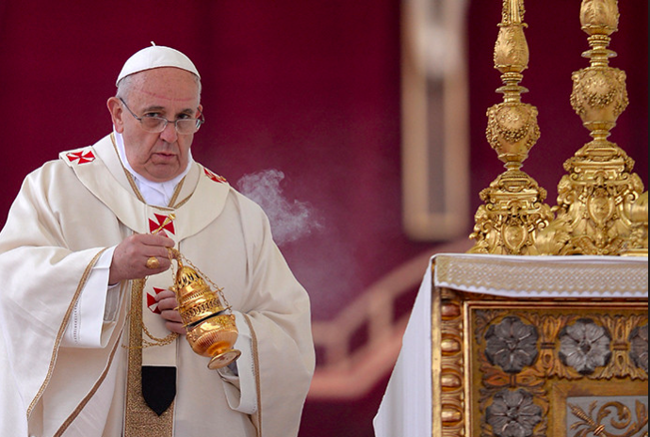

Slide 18
³ Then Mary took about a pint of pure nard, an expensive perfume; she poured it on Jesus’ feet and wiped his feet with her hair. And the house was filled with the fragrance of the perfume.

Slide 19
By anointing Jesus with perfume, Mary was:
Extravagant
Personal
Worshipful

Slide 20
An insincere objection. . .

Slide 21
⁴ But one of his disciples, Judas Iscariot, who was later to betray him, objected, ⁵ “Why wasn’t this perfume sold and the money given to the poor? It was worth a year’s wages.” ⁶ He did not say this because he cared about the poor but because he was a thief; as keeper of the money bag, he used to help himself to what was put into it.

Slide 22
⁷ “Leave her alone,” Jesus replied. “It was intended that she should save this perfume for the day of my burial. ⁸ You will always have the poor among you, but you will not always have me.”
John 12:1-8

Slide 23
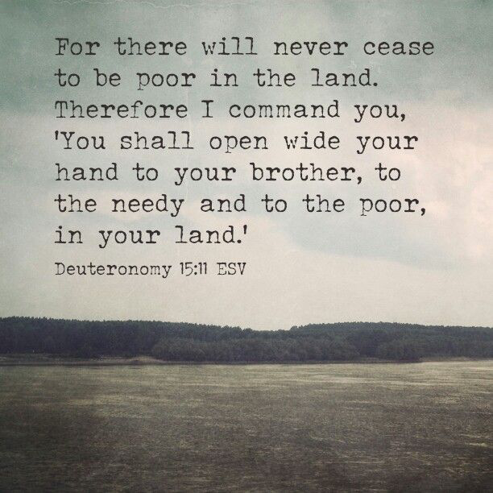

Slide 24
Lesson for disciples

Slide 25
Renew our love and adoration for Jesus.

Slide 26
