Slide 1
Church
Healthy Characteristics: Biblical Accountability, Giving & Mission

Slide 2

National Community Church

Slide 3
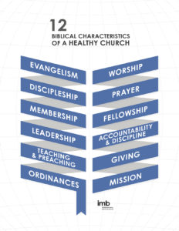

Slide 4
Biblical Accountability & Discipline

Slide 5
Therefore confess your sins to each other and pray for each other so that you may be healed. The prayer of a righteous person is powerful and effective.
James 5:16

Slide 6


Slide 7
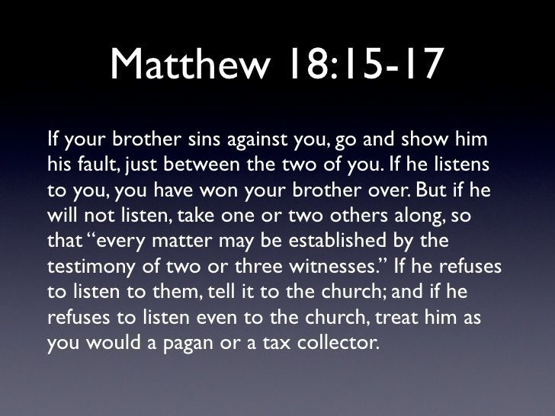

Slide 8


Slide 9
Biblical Giving

Slide 10
¹ Now about the collection for the Lord’s people: Do what I told the Galatian churches to do. ² On the first day of every week, each one of you should set aside a sum of money in keeping with your income, saving it up, so that when I come no collections will have to be made. ³ Then, when I arrive, I will give letters of introduction to the men you approve and send them with your gift to Jerusalem.
I Corinthians 16:1-3

Slide 11
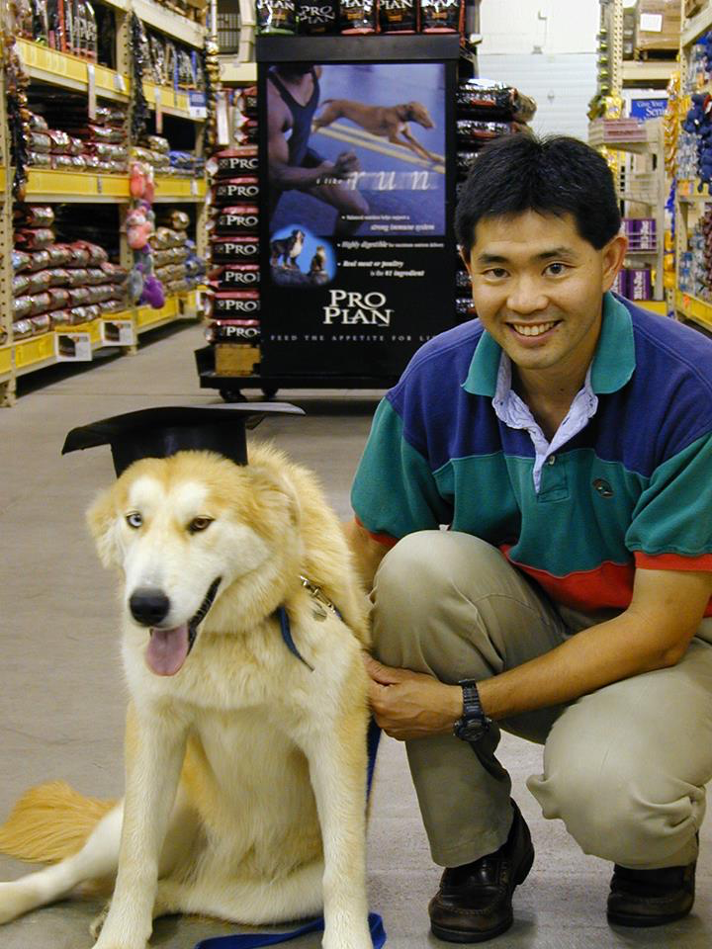

Slide 12
⁷ Each of you should give what you have decided in your heart to give, not reluctantly or under compulsion, for God loves a cheerful giver. ⁸ And God is able to bless you abundantly, so that in all things at all times, having all that you need, you will abound in every good work.
2 Corinthians 9

Slide 13
Biblical Mission

Slide 14
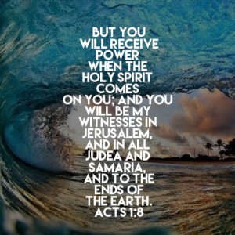

Slide 15


Slide 16
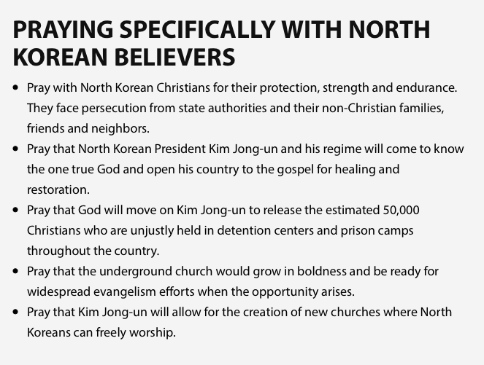

Slide 17
Lessons for disciples

Slide 18
Consider Accountability
Decide to Give
Pray for Mission

Slide 19
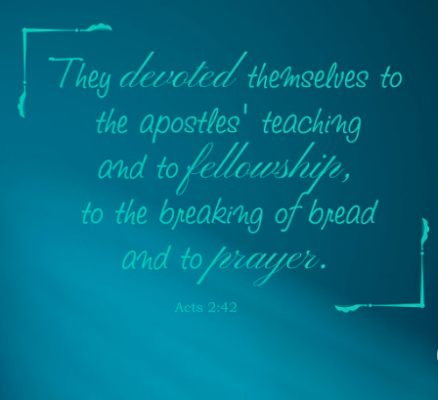

Slide 20


