Slide 1
The Glory of God
Columbia Chinese Christian Church 2017.5.21
Notes:
There was a rumor on this campus that today’s speaker knows everybody in China. Let me tell you the origin of this rumor with a metaphor. Once deep in the jungle lived a fox, who was one day caught by a tiger. The tiger played with his snack by engaging with the fox a conversation. “How are you doing?” the tiger asked. “Very well sir”, the fox replied, and added another line “in fact, I am feeling extremely well these days?”. “May I ask you why”, the tiger asked. “Oh, don’t you know”, the fox replied, “that all animals of the jungle just elected me as the king of this jungle”. “Oh, really”, the tiger said, “I thought I am the king of this jungle”. “Let’s take a walk, and you will see”, the fox suggested. So together, they took a walk into the jungle, with the fox swaggers down the road, and the tiger following behind. All the animals in the jungle receded respectfully before the fox. That was what happened during my trip to China with our President and Provost. The reason why it appears that I seemingly know everybody in China, because of the two bengal tigers following behind; Bengal tigers are sometimes white in case you don’t know. The name of CIU is well respected among churches in China, because many CIU graduates have been laboring deligently on that piece of land, and most of them served anymously, which means they deliberately conceal their identities in order to serve more efficiently.

Slide 2
Isaiah 6:1-8
6 In the year of King Uzziah’s death I saw the Lord sitting on a throne, lofty and exalted, with the train of His robe filling the temple. ² Seraphim stood above Him, each having six wings: with two he covered his face, and with two he covered his feet, and with two he flew. ³ And one called out to another and said,
“Holy, Holy, Holy, is the Lord of hosts, The whole earth is full of His glory.”
⁴ And the foundations of the thresholds trembled at the voice of him who called out, while the temple was filling with smoke. ⁵ Then I said,
“Woe is me, for I am ruined! Because I am a man of unclean lips, And I live among a people of unclean lips; For my eyes have seen the King, the Lord of hosts.”
⁶ Then one of the seraphim flew to me with a burning coal in his hand, which he had taken from the altar with tongs. ⁷ He touched my mouth with it and said, “Behold, this has touched your lips; and your iniquity is taken away and your sin is ^{[d]}forgiven.”
Notes:
Seraphim are fiery angelic beings, who reflect the glory of God;
The sense is well expressed by the Targum: “With two he covered his face that he might not see; and with two he covered his body that he might not be seen.”
Seraphim as angelic creature can not gaze up the dazzling glory of the divine face; In front of the divine majesty, even the angels cover their face; and the prophet immediately realized the sin of himself and his people.
The upper and lower wings that cover the face and the feet, these are wings of humility; The face need to be covered, because we are creatures dare not look straight into the divine glory; we as creatures dare not to show off ourselves as we serve the glorious God; The feet need to be covered, because what we did, even those most righteous needs, are but filthy garments (Isaiah 64:6)

Slide 3
撒拉弗

Slide 4
Joy on 2016 Mission China 2030
Notes:
Joy: hidden face, hidden name; Afganistian Missionary; grew up in Shanghai, came to the states for high education; settled down in CA; became Christians; felt the calling to be missionaries in Afganistian, she, her husband and their two daughters;
Not for fame, not for gain, yet risk their lives all the time;

Slide 5
CIM Missionaries with No Names
Notes:
We want to be celebrities; we want our names to be remembered by scribing them into stone, or positing on instagram; to post selfies here and there; leaving electronic traits that exist permeantly; My our culture actually prescribes three ways of effectively establish a name when you are alive or after you pass away: that is through great accomplishment; three extremely words (like beautiful poems and literature) or through virtuous deeds that impact as many people as possible. There are the three ways people will remember you, even after you die.
London Missionary Society, Missionary Archives; whole basement, like a warehouse;

Slide 6
Two CIM Missionaries in XinJiang
Notes:
Dr. Percy Cunningham Mather (马尔昌）: 2nd CIM missionary to XinJiang; He gave his life Jesus Christ by serving in a most inhospitable place: Chinese Turkistan. Percy Mather died in 1933 at the age of 51, and was buried in XinJiang.
Dr. Fischbacher （巴富义）：was born in Glasgow Scotland, August 9 1903. He gained his Physician and Surgeon License. He was called to serve with the CIM and left London for China on Dircember 31 1931. He arrived in Urumqi on November 9 1932. Dr. Fischbacher died on May 27, 1933 of Typhus which he contracted during surgical procedure for local patience. He died at the age of 30.

Slide 7
Unknown to the World Yet Known to God
Notes:
Here Rests in Honored Glory A Kingdom Soldier; Known to no one but to God!
Just like the Seraphim, these servants covers their faces, and their feet; serving not for their own glory or recognition, their righteous deeds were unknown to the world, yet Known to the Lord!
These Kingdom servants reflects the glory of God; Seraphim reflect the glory of God
What is this glory of God?

Slide 8
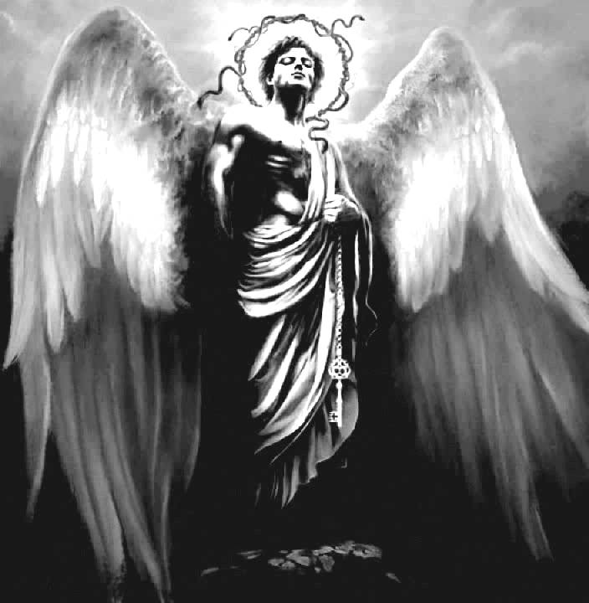
Seraphim vs. Lucifer
Notes:
Lucifer probably is not less beautiful, intelligent or gifted than Seraphim; Why he chose to rebel?
The origin of devil has always been a puzzled mystery in systematic theology; Somewhere between Gen 1:31 and Gen 3:1, there was an insurgence, or riot, happened in the heavenly realm. No biblical scholar knows what exactly happened. As I am preparing this message, some insights came to my mind. What lies at the center of demonic motivation might well be the jealousy, the jealousy of divine love for human being. Before man was created, angels must be the Creator’s favorite creature. And then God created Adam in His very own image and likeness; God prepared a garden for human beings, and give them the authority ruling the earth; The angels as part of divine council could have known about the pactum saltuis (a pact or a covenant that the Father enters into with the pre-incarnate Son; the pactum refers to the Father’s “eternal appointment of the Son of God, by way of covenant, to become the incarnate redeemer and head of his adopted siblings). As they learn more about the divine plan of redemption for human being, as it is indicated in 1 Peter 1:12 (… things into which angels long to look); The angels realized that human beings, rather than them, are the favorite creatures of the Creator. Some of the angels they became very jealousy, and rebelled. Because they were jealous, they became enemy of human beings, stirring up God to test human being (as we see in the book of Job), they accuse human representatives (as in Zechariah 3:1), they attacked and made every effort to deceit human beings (as in Genesis 3), they wanted to torpedo the salvation by tempting the saviour (as in Matthew 4), they were called the accuser of our brethren (as in Rev. 12:10).
It is the pride that caused devil to fall; the self pride preclude the devil from embracing human beings. The devil’s pride soared to the height of demanding to share the divine glory (Isaiah 14:12)

Slide 9
The Kenosis of Jesus
⁵ Have this attitude in yourselves which was also in Christ Jesus,
⁶ who, although He existed in the form of God, did not regard equality with God a thing to be grasped,
⁷ but emptied Himself, taking the form of a bond-servant, and being made in the likeness of men.
⁸ Being found in appearance as a man, He humbled Himself by becoming obedient to the point of death, even death on a cross.
⁹ For this reason also, God highly exalted Him, and bestowed on Him the name which is above every name,
¹⁰ so that at the name of Jesus every knee will bow, of those who are in heaven and on earth and under the earth,
¹¹ and that every tongue will confess that Jesus Christ is Lord, to the glory of God the Father.
Notes:
The dazzling glory that the Seraphim could not gaze directly is the glory that manifested in Christ;
It is the trinitarian glory of the three persons in the Godhead; each opens up embracing the others, each respects the others, cooperates with the others, loves the others.
Each divine person have the capacity behaving in this manner, because the divine persons are not stubborn, self-centered, hard, snobby, me-first kind of being. The trinitarian God differs from those kind of rigid monotheism that believes in sheer power, in conquering, in shoving other around to make room for self, in subduing the others, or killing others (if others refuse to submit).
This is the kind of dazzling glory reflected by these kingdom servants, by the Seraphim, and the Spirit that’s moving on this campus.

Slide 10
Before the Kenotic Passage was Paul’s urge to the Philippians …
³ Do nothing from selfishness or empty conceit, but with humility of mind regard one another as more important than yourselves;
⁴ do not merely look out for your own personal interests, but also for the interests of others.
⁵ Have this attitude in yourselves which was also in Christ Jesus,
Notes:
We regard you the board as more important that the faculty, the staff and the students, and are willing to submit to your decision;
Yet you, in your humility, involved us in this decision making process; this truly is very unconventional for any institute;
The Christ-like, kenotic manner brought healing to the faculty and staff team, for we have been bleeding since last summer after some tough decision;
Your humble leadership style, I believe, strengthened the unity of this campus, and enhanced the morale of this community.
Thank you!

Slide 11
You Are My Hiding Place
Notes:
I have been pondering about the life of John the Evangelist, and was amazed by his transformation.
He and his brother James once were very assertive person who strived to be number one among the disciples. They had constant tension with Peter, and the tension sometime erupted in episodes like Matthew 20, where their mother under the urge of her sons implored Jesus for high positions in the future Kingdom. This request elicited indignation from their fellow disciples, especially Peter.
Yet, later on, John the once proactive seeker of fame and recognition intended to hide his identity while writing the Gospel of John, the marvelous piece with eternal value, which can be the one-time-in-life occasion of earning him immortal fame. Why was the case? Why such a dramatic change? It was because of the Cross. The knenotic spirit of Christ infused and imputed in him, and transformed him into a new person, transforming him from a self-centered person to a Kingdom-centered Christ-like figure who hid both his face and his feet. Being Christ-like with deep prehension of kenotic spirit forms the foundation for apostilic unity, because they all consider themselves as servants who serve the same King for the same cause. It was with this kind of spirit that Peter, James and John they untied as one, they were able to share the deep communion. Liberal scholars attempted to drive wedges inbetween Pauline, Johannine and Petrine literatures, assuming they all compete for their fame among the early churches. I believe the liberals are wrong on this point because, with their unregenerated heart, they do not understand this kenotic Christ-like spirit.

Slide 12
The Trinitarian God
Notes:
The Chinese history saturates itself with violence, warfare and bloodshed.
Most of them were caused by power struggles; allowing only the most vicious grabbing the power as private possession.
We invent fairy tale utopians in which the sage yield his position to another sage voluntarily, yet we have seldom, or never seen this happened in real history.
It is not easy, after all, to overcome our sense of insecurity and to empty ourselves, or to kenotically humble ourselves.
We all had the experience of being rejected, or sometimes rejecting others; Schism, separation, division, backstabings have been quite prevalent among Christian circles; All these violate directly the trinitarian model of existence. It is true that sometime we do need to hold the criteria for orthodoxy, and division and separation can be worthy for the truth’s sake. Yet how many schisms and separations happened because deep down there we were unwilling to open up, unwilling to embrace, unwilling to cooperate. We want to conqure, we want to subdue, we want to exalt ourselves, and we did it sometimes in the most humble, elegant, delicate, polite or even godly manner that we even smack on our skillfulness. Yet the problem is still there. By exclude others, we are still a goat, not a sheep; we are still loners, rather than communioners.
Strong leaders co-exist harmoniously in the team, each serving according to his/her unique talent; yet each respects the others, building up the others, strengthening the others, and regards others as more important than him/herself
That is very rare in this world; That is the glory of Trinitarian God; that is the perocherotic harmony between the divine persons in the Trinity.
We celebrate the display of this divine glory on this campus; we look forward to a future…
When professors and the professors emeritus

Slide 13
Ephesians 2:3 with various translations…
We look forward into a future, when our fellowship will be a place…
“… in humility value others above yourselves [themselves]” (NIV)
“… be humble, thinking of others as better than yourselves [themselves]” (NLT)
“… in humility count others more significant than yourselves [themselves]” (ESV)
“… with humility of mind regard one another as more important than yourselves [themselves]” (NASB)
“… in lowliness of mind let each esteem other better than themselves” (KJV)

