Slide 1
We need to change
Isaiah 10

Slide 3
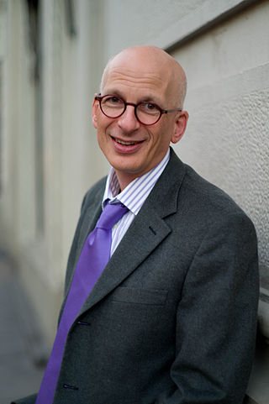
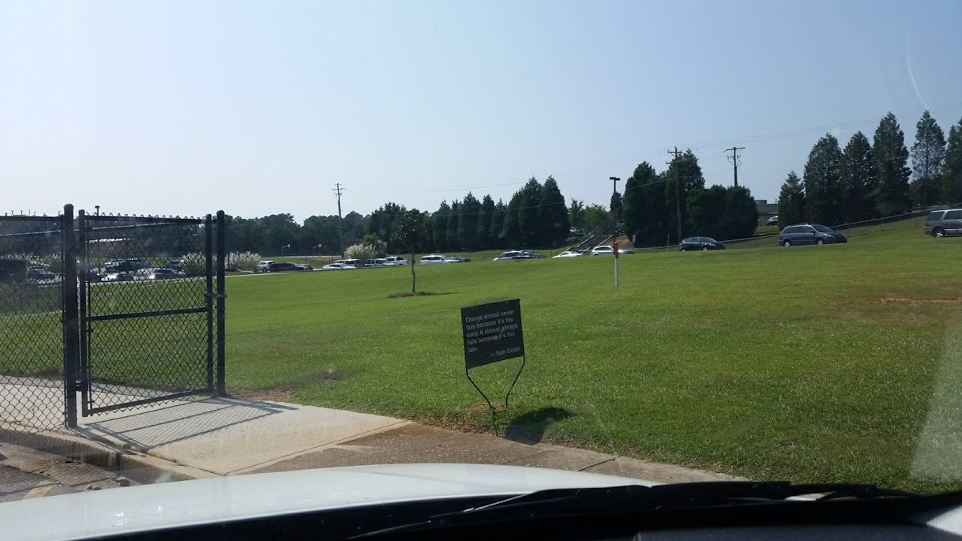
“Change almost never fails because it's too early. It almost always fails because it's too late.” ― Seth Godin
Notes:
38分少3秒

Slide 4
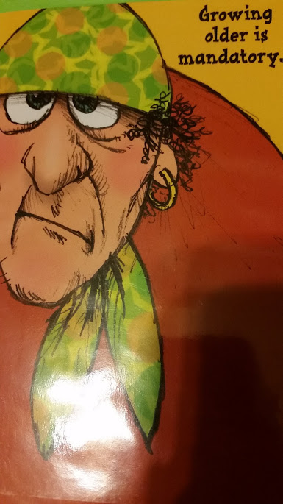
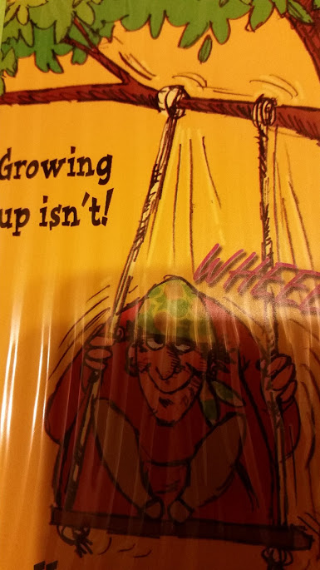

Slide 5
Two Questions:
Where are we changing from?
Where are we changing to?

Slide 6
Isaiah 10:1 Woe to those who make unjust laws, to those who issue oppressive decrees, 2 to deprive the poor of their rights and withhold justice from the oppressed of my people, making widows their prey and robbing the fatherless. 3 What will you do on the day of reckoning, when disaster comes from afar? To whom will you run for help? Where will you leave your riches? 4 Nothing will remain but to cringe among the captives or fall among the slain. Yet for all this, his anger is not turned away, his hand is still upraised.
Notes:
Isaiah 10:1 Woe to those who make unjust laws, to those who issue oppressive decrees, 2 to deprive the poor of their rights and withhold justice from the oppressed of my people, making widows their prey and robbing the fatherless. 3 What will you do on the day of reckoning, when disaster comes from afar? To whom will you run for help? Where will you leave your riches? 4 Nothing will remain but to cringe among the captives or fall among the slain. Yet for all this, his anger is not turned away, his hand is still upraised. God’s Judgment on Assyria 5 “Woe to the Assyrian, the rod of my anger, in whose hand is the club of my wrath! 6 I send him against a godless nation, I dispatch him against a people who anger me, to seize loot and snatch plunder, and to trample them down like mud in the streets. 7 But this is not what he intends, this is not what he has in mind; his purpose is to destroy, to put an end to many nations. 8 ‘Are not my commanders all kings?’ he says. 9 ‘Has not Kalno fared like Carchemish? Is not Hamath like Arpad, and Samaria like Damascus? 10 As my hand seized the kingdoms of the idols, kingdoms whose images excelled those of Jerusalem and Samaria— 11 shall I not deal with Jerusalem and her images as I dealt with Samaria and her idols?’” 12 When the Lord has finished all his work against Mount Zion and Jerusalem, he will say, “I will punish the king of Assyria for the willful pride of his heart and the haughty look in his eyes. 13 For he says: “‘By the strength of my hand I have done this, and by my wisdom, because I have understanding. I removed the boundaries of nations, I plundered their treasures; like a mighty one I subdued[a] their kings. 14 As one reaches into a nest, so my hand reached for the wealth of the nations; as people gather abandoned eggs, so I gathered all the countries; not one flapped a wing, or opened its mouth to chirp.’” 15 Does the ax raise itself above the person who swings it, or the saw boast against the one who uses it? As if a rod were to wield the person who lifts it up, or a club brandish the one who is not wood! 16 Therefore, the Lord, the Lord Almighty, will send a wasting disease upon his sturdy warriors; under his pomp a fire will be kindled like a blazing flame. 17 The Light of Israel will become a fire, their Holy One a flame; in a single day it will burn and consume his thorns and his briers. 18 The splendor of his forests and fertile fields it will completely destroy, as when a sick person wastes away. 19 And the remaining trees of his forests will be so few that a child could write them down. The Remnant of Israel 20 In that day the remnant of Israel, the survivors of Jacob, will no longer rely on him who struck them down but will truly rely on the Lord, the Holy One of Israel. 21 A remnant will return,[b] a remnant of Jacob will return to the Mighty God. 22 Though your people be like the sand by the sea, Israel, only a remnant will return. Destruction has been decreed, overwhelming and righteous. 23 The Lord, the Lord Almighty, will carry out the destruction decreed upon the whole land. 24 Therefore this is what the Lord, the Lord Almighty, says: “My people who live in Zion, do not be afraid of the Assyrians, who beat you with a rod and lift up a club against you, as Egypt did. 25 Very soon my anger against you will end and my wrath will be directed to their destruction.” 26 The Lord Almighty will lash them with a whip, as when he struck down Midian at the rock of Oreb; and he will raise his staff over the waters, as he did in Egypt. 27 In that day their burden will be lifted from your shoulders, their yoke from your neck; the yoke will be broken because you have grown so fat.[c] 28 They enter Aiath; they pass through Migron; they store supplies at Mikmash. 29 They go over the pass, and say, “We will camp overnight at Geba.” Ramah trembles; Gibeah of Saul flees. 30 Cry out, Daughter Gallim! Listen, Laishah! Poor Anathoth! 31 Madmenah is in flight; the people of Gebim take cover. 32 This day they will halt at Nob; they will shake their fist at the mount of Daughter Zion, at the hill of Jerusalem. 33 See, the Lord, the Lord Almighty, will lop off the boughs with great power. The lofty trees will be felled, the tall ones will be brought low. 34 He will cut down the forest thickets with an ax; Lebanon will fall before the Mighty One.

Slide 7
Isaiah 10:5 “Woe to the Assyrian, the rod of my anger, in whose hand is the club of my wrath! 6 I send him against a godless nation, I dispatch him against a people who anger me, to seize loot and snatch plunder, and to trample them down like mud in the streets. 7 But this is not what he intends, this is not what he has in mind; his purpose is to destroy, to put an end to many nations. 8 ‘Are not my commanders all kings?’ he says. 9 ‘Has not Kalno fared like Carchemish? Is not Hamath like Arpad, and Samaria like Damascus?
Notes:
Isaiah 10:1 Woe to those who make unjust laws, to those who issue oppressive decrees, 2 to deprive the poor of their rights and withhold justice from the oppressed of my people, making widows their prey and robbing the fatherless. 3 What will you do on the day of reckoning, when disaster comes from afar? To whom will you run for help? Where will you leave your riches? 4 Nothing will remain but to cringe among the captives or fall among the slain. Yet for all this, his anger is not turned away, his hand is still upraised. God’s Judgment on Assyria 5 “Woe to the Assyrian, the rod of my anger, in whose hand is the club of my wrath! 6 I send him against a godless nation, I dispatch him against a people who anger me, to seize loot and snatch plunder, and to trample them down like mud in the streets. 7 But this is not what he intends, this is not what he has in mind; his purpose is to destroy, to put an end to many nations. 8 ‘Are not my commanders all kings?’ he says. 9 ‘Has not Kalno fared like Carchemish? Is not Hamath like Arpad, and Samaria like Damascus? 10 As my hand seized the kingdoms of the idols, kingdoms whose images excelled those of Jerusalem and Samaria— 11 shall I not deal with Jerusalem and her images as I dealt with Samaria and her idols?’” 12 When the Lord has finished all his work against Mount Zion and Jerusalem, he will say, “I will punish the king of Assyria for the willful pride of his heart and the haughty look in his eyes. 13 For he says: “‘By the strength of my hand I have done this, and by my wisdom, because I have understanding. I removed the boundaries of nations, I plundered their treasures; like a mighty one I subdued[a] their kings. 14 As one reaches into a nest, so my hand reached for the wealth of the nations; as people gather abandoned eggs, so I gathered all the countries; not one flapped a wing, or opened its mouth to chirp.’” 15 Does the ax raise itself above the person who swings it, or the saw boast against the one who uses it? As if a rod were to wield the person who lifts it up, or a club brandish the one who is not wood! 16 Therefore, the Lord, the Lord Almighty, will send a wasting disease upon his sturdy warriors; under his pomp a fire will be kindled like a blazing flame. 17 The Light of Israel will become a fire, their Holy One a flame; in a single day it will burn and consume his thorns and his briers. 18 The splendor of his forests and fertile fields it will completely destroy, as when a sick person wastes away. 19 And the remaining trees of his forests will be so few that a child could write them down. The Remnant of Israel 20 In that day the remnant of Israel, the survivors of Jacob, will no longer rely on him who struck them down but will truly rely on the Lord, the Holy One of Israel. 21 A remnant will return,[b] a remnant of Jacob will return to the Mighty God. 22 Though your people be like the sand by the sea, Israel, only a remnant will return. Destruction has been decreed, overwhelming and righteous. 23 The Lord, the Lord Almighty, will carry out the destruction decreed upon the whole land. 24 Therefore this is what the Lord, the Lord Almighty, says: “My people who live in Zion, do not be afraid of the Assyrians, who beat you with a rod and lift up a club against you, as Egypt did. 25 Very soon my anger against you will end and my wrath will be directed to their destruction.” 26 The Lord Almighty will lash them with a whip, as when he struck down Midian at the rock of Oreb; and he will raise his staff over the waters, as he did in Egypt. 27 In that day their burden will be lifted from your shoulders, their yoke from your neck; the yoke will be broken because you have grown so fat.[c] 28 They enter Aiath; they pass through Migron; they store supplies at Mikmash. 29 They go over the pass, and say, “We will camp overnight at Geba.” Ramah trembles; Gibeah of Saul flees. 30 Cry out, Daughter Gallim! Listen, Laishah! Poor Anathoth! 31 Madmenah is in flight; the people of Gebim take cover. 32 This day they will halt at Nob; they will shake their fist at the mount of Daughter Zion, at the hill of Jerusalem. 33 See, the Lord, the Lord Almighty, will lop off the boughs with great power. The lofty trees will be felled, the tall ones will be brought low. 34 He will cut down the forest thickets with an ax; Lebanon will fall before the Mighty One.

Slide 8
Isaiah 10:10 As my hand seized the kingdoms of the idols, kingdoms whose images excelled those of Jerusalem and Samaria— 11 shall I not deal with Jerusalem and her images as I dealt with Samaria and her idols?’” 12 When the Lord has finished all his work against Mount Zion and Jerusalem, he will say, “I will punish the king of Assyria for the willful pride of his heart and the haughty look in his eyes.
Notes:
Isaiah 10:1 Woe to those who make unjust laws, to those who issue oppressive decrees, 2 to deprive the poor of their rights and withhold justice from the oppressed of my people, making widows their prey and robbing the fatherless. 3 What will you do on the day of reckoning, when disaster comes from afar? To whom will you run for help? Where will you leave your riches? 4 Nothing will remain but to cringe among the captives or fall among the slain. Yet for all this, his anger is not turned away, his hand is still upraised. God’s Judgment on Assyria 5 “Woe to the Assyrian, the rod of my anger, in whose hand is the club of my wrath! 6 I send him against a godless nation, I dispatch him against a people who anger me, to seize loot and snatch plunder, and to trample them down like mud in the streets. 7 But this is not what he intends, this is not what he has in mind; his purpose is to destroy, to put an end to many nations. 8 ‘Are not my commanders all kings?’ he says. 9 ‘Has not Kalno fared like Carchemish? Is not Hamath like Arpad, and Samaria like Damascus? 10 As my hand seized the kingdoms of the idols, kingdoms whose images excelled those of Jerusalem and Samaria— 11 shall I not deal with Jerusalem and her images as I dealt with Samaria and her idols?’” 12 When the Lord has finished all his work against Mount Zion and Jerusalem, he will say, “I will punish the king of Assyria for the willful pride of his heart and the haughty look in his eyes. 13 For he says: “‘By the strength of my hand I have done this, and by my wisdom, because I have understanding. I removed the boundaries of nations, I plundered their treasures; like a mighty one I subdued[a] their kings. 14 As one reaches into a nest, so my hand reached for the wealth of the nations; as people gather abandoned eggs, so I gathered all the countries; not one flapped a wing, or opened its mouth to chirp.’” 15 Does the ax raise itself above the person who swings it, or the saw boast against the one who uses it? As if a rod were to wield the person who lifts it up, or a club brandish the one who is not wood! 16 Therefore, the Lord, the Lord Almighty, will send a wasting disease upon his sturdy warriors; under his pomp a fire will be kindled like a blazing flame. 17 The Light of Israel will become a fire, their Holy One a flame; in a single day it will burn and consume his thorns and his briers. 18 The splendor of his forests and fertile fields it will completely destroy, as when a sick person wastes away. 19 And the remaining trees of his forests will be so few that a child could write them down. The Remnant of Israel 20 In that day the remnant of Israel, the survivors of Jacob, will no longer rely on him who struck them down but will truly rely on the Lord, the Holy One of Israel. 21 A remnant will return,[b] a remnant of Jacob will return to the Mighty God. 22 Though your people be like the sand by the sea, Israel, only a remnant will return. Destruction has been decreed, overwhelming and righteous. 23 The Lord, the Lord Almighty, will carry out the destruction decreed upon the whole land. 24 Therefore this is what the Lord, the Lord Almighty, says: “My people who live in Zion, do not be afraid of the Assyrians, who beat you with a rod and lift up a club against you, as Egypt did. 25 Very soon my anger against you will end and my wrath will be directed to their destruction.” 26 The Lord Almighty will lash them with a whip, as when he struck down Midian at the rock of Oreb; and he will raise his staff over the waters, as he did in Egypt. 27 In that day their burden will be lifted from your shoulders, their yoke from your neck; the yoke will be broken because you have grown so fat.[c] 28 They enter Aiath; they pass through Migron; they store supplies at Mikmash. 29 They go over the pass, and say, “We will camp overnight at Geba.” Ramah trembles; Gibeah of Saul flees. 30 Cry out, Daughter Gallim! Listen, Laishah! Poor Anathoth! 31 Madmenah is in flight; the people of Gebim take cover. 32 This day they will halt at Nob; they will shake their fist at the mount of Daughter Zion, at the hill of Jerusalem. 33 See, the Lord, the Lord Almighty, will lop off the boughs with great power. The lofty trees will be felled, the tall ones will be brought low. 34 He will cut down the forest thickets with an ax; Lebanon will fall before the Mighty One.

Slide 9
Isaiah 10:13 For he says: “‘By the strength of my hand I have done this, and by my wisdom, because I have understanding. I removed the boundaries of nations, I plundered their treasures; like a mighty one I subdued[a] their kings. 14 As one reaches into a nest, so my hand reached for the wealth of the nations; as people gather abandoned eggs, so I gathered all the countries; not one flapped a wing, or opened its mouth to chirp.’”
Notes:
Isaiah 10:1 Woe to those who make unjust laws, to those who issue oppressive decrees, 2 to deprive the poor of their rights and withhold justice from the oppressed of my people, making widows their prey and robbing the fatherless. 3 What will you do on the day of reckoning, when disaster comes from afar? To whom will you run for help? Where will you leave your riches? 4 Nothing will remain but to cringe among the captives or fall among the slain. Yet for all this, his anger is not turned away, his hand is still upraised. God’s Judgment on Assyria 5 “Woe to the Assyrian, the rod of my anger, in whose hand is the club of my wrath! 6 I send him against a godless nation, I dispatch him against a people who anger me, to seize loot and snatch plunder, and to trample them down like mud in the streets. 7 But this is not what he intends, this is not what he has in mind; his purpose is to destroy, to put an end to many nations. 8 ‘Are not my commanders all kings?’ he says. 9 ‘Has not Kalno fared like Carchemish? Is not Hamath like Arpad, and Samaria like Damascus? 10 As my hand seized the kingdoms of the idols, kingdoms whose images excelled those of Jerusalem and Samaria— 11 shall I not deal with Jerusalem and her images as I dealt with Samaria and her idols?’” 12 When the Lord has finished all his work against Mount Zion and Jerusalem, he will say, “I will punish the king of Assyria for the willful pride of his heart and the haughty look in his eyes. 13 For he says: “‘By the strength of my hand I have done this, and by my wisdom, because I have understanding. I removed the boundaries of nations, I plundered their treasures; like a mighty one I subdued[a] their kings. 14 As one reaches into a nest, so my hand reached for the wealth of the nations; as people gather abandoned eggs, so I gathered all the countries; not one flapped a wing, or opened its mouth to chirp.’” 15 Does the ax raise itself above the person who swings it, or the saw boast against the one who uses it? As if a rod were to wield the person who lifts it up, or a club brandish the one who is not wood! 16 Therefore, the Lord, the Lord Almighty, will send a wasting disease upon his sturdy warriors; under his pomp a fire will be kindled like a blazing flame. 17 The Light of Israel will become a fire, their Holy One a flame; in a single day it will burn and consume his thorns and his briers. 18 The splendor of his forests and fertile fields it will completely destroy, as when a sick person wastes away. 19 And the remaining trees of his forests will be so few that a child could write them down. The Remnant of Israel 20 In that day the remnant of Israel, the survivors of Jacob, will no longer rely on him who struck them down but will truly rely on the Lord, the Holy One of Israel. 21 A remnant will return,[b] a remnant of Jacob will return to the Mighty God. 22 Though your people be like the sand by the sea, Israel, only a remnant will return. Destruction has been decreed, overwhelming and righteous. 23 The Lord, the Lord Almighty, will carry out the destruction decreed upon the whole land. 24 Therefore this is what the Lord, the Lord Almighty, says: “My people who live in Zion, do not be afraid of the Assyrians, who beat you with a rod and lift up a club against you, as Egypt did. 25 Very soon my anger against you will end and my wrath will be directed to their destruction.” 26 The Lord Almighty will lash them with a whip, as when he struck down Midian at the rock of Oreb; and he will raise his staff over the waters, as he did in Egypt. 27 In that day their burden will be lifted from your shoulders, their yoke from your neck; the yoke will be broken because you have grown so fat.[c] 28 They enter Aiath; they pass through Migron; they store supplies at Mikmash. 29 They go over the pass, and say, “We will camp overnight at Geba.” Ramah trembles; Gibeah of Saul flees. 30 Cry out, Daughter Gallim! Listen, Laishah! Poor Anathoth! 31 Madmenah is in flight; the people of Gebim take cover. 32 This day they will halt at Nob; they will shake their fist at the mount of Daughter Zion, at the hill of Jerusalem. 33 See, the Lord, the Lord Almighty, will lop off the boughs with great power. The lofty trees will be felled, the tall ones will be brought low. 34 He will cut down the forest thickets with an ax; Lebanon will fall before the Mighty One.

Slide 10
Isaiah 10:15 Does the ax raise itself above the person who swings it, or the saw boast against the one who uses it? As if a rod were to wield the person who lifts it up, or a club brandish the one who is not wood! 16 Therefore, the Lord, the Lord Almighty, will send a wasting disease upon his sturdy warriors; under his pomp a fire will be kindled like a blazing flame. 17 The Light of Israel will become a fire, their Holy One a flame; in a single day it will burn and consume his thorns and his briers.
Notes:
Isaiah 10:1 Woe to those who make unjust laws, to those who issue oppressive decrees, 2 to deprive the poor of their rights and withhold justice from the oppressed of my people, making widows their prey and robbing the fatherless. 3 What will you do on the day of reckoning, when disaster comes from afar? To whom will you run for help? Where will you leave your riches? 4 Nothing will remain but to cringe among the captives or fall among the slain. Yet for all this, his anger is not turned away, his hand is still upraised. God’s Judgment on Assyria 5 “Woe to the Assyrian, the rod of my anger, in whose hand is the club of my wrath! 6 I send him against a godless nation, I dispatch him against a people who anger me, to seize loot and snatch plunder, and to trample them down like mud in the streets. 7 But this is not what he intends, this is not what he has in mind; his purpose is to destroy, to put an end to many nations. 8 ‘Are not my commanders all kings?’ he says. 9 ‘Has not Kalno fared like Carchemish? Is not Hamath like Arpad, and Samaria like Damascus? 10 As my hand seized the kingdoms of the idols, kingdoms whose images excelled those of Jerusalem and Samaria— 11 shall I not deal with Jerusalem and her images as I dealt with Samaria and her idols?’” 12 When the Lord has finished all his work against Mount Zion and Jerusalem, he will say, “I will punish the king of Assyria for the willful pride of his heart and the haughty look in his eyes. 13 For he says: “‘By the strength of my hand I have done this, and by my wisdom, because I have understanding. I removed the boundaries of nations, I plundered their treasures; like a mighty one I subdued[a] their kings. 14 As one reaches into a nest, so my hand reached for the wealth of the nations; as people gather abandoned eggs, so I gathered all the countries; not one flapped a wing, or opened its mouth to chirp.’” 15 Does the ax raise itself above the person who swings it, or the saw boast against the one who uses it? As if a rod were to wield the person who lifts it up, or a club brandish the one who is not wood! 16 Therefore, the Lord, the Lord Almighty, will send a wasting disease upon his sturdy warriors; under his pomp a fire will be kindled like a blazing flame. 17 The Light of Israel will become a fire, their Holy One a flame; in a single day it will burn and consume his thorns and his briers. 18 The splendor of his forests and fertile fields it will completely destroy, as when a sick person wastes away. 19 And the remaining trees of his forests will be so few that a child could write them down. The Remnant of Israel 20 In that day the remnant of Israel, the survivors of Jacob, will no longer rely on him who struck them down but will truly rely on the Lord, the Holy One of Israel. 21 A remnant will return,[b] a remnant of Jacob will return to the Mighty God. 22 Though your people be like the sand by the sea, Israel, only a remnant will return. Destruction has been decreed, overwhelming and righteous. 23 The Lord, the Lord Almighty, will carry out the destruction decreed upon the whole land. 24 Therefore this is what the Lord, the Lord Almighty, says: “My people who live in Zion, do not be afraid of the Assyrians, who beat you with a rod and lift up a club against you, as Egypt did. 25 Very soon my anger against you will end and my wrath will be directed to their destruction.” 26 The Lord Almighty will lash them with a whip, as when he struck down Midian at the rock of Oreb; and he will raise his staff over the waters, as he did in Egypt. 27 In that day their burden will be lifted from your shoulders, their yoke from your neck; the yoke will be broken because you have grown so fat.[c] 28 They enter Aiath; they pass through Migron; they store supplies at Mikmash. 29 They go over the pass, and say, “We will camp overnight at Geba.” Ramah trembles; Gibeah of Saul flees. 30 Cry out, Daughter Gallim! Listen, Laishah! Poor Anathoth! 31 Madmenah is in flight; the people of Gebim take cover. 32 This day they will halt at Nob; they will shake their fist at the mount of Daughter Zion, at the hill of Jerusalem. 33 See, the Lord, the Lord Almighty, will lop off the boughs with great power. The lofty trees will be felled, the tall ones will be brought low. 34 He will cut down the forest thickets with an ax; Lebanon will fall before the Mighty One.

Slide 11
Isaiah 10:20 In that day the remnant of Israel, the survivors of Jacob, will no longer rely on him who struck them down but will truly rely on the Lord, the Holy One of Israel. 21 A remnant will return, a remnant of Jacob will return to the Mighty God. 22 Though your people be like the sand by the sea, Israel, only a remnant will return. Destruction has been decreed, overwhelming and righteous. 23 The Lord, the Lord Almighty, will carry out the destruction decreed upon the whole land.
Notes:
Isaiah 10:1 Woe to those who make unjust laws, to those who issue oppressive decrees, 2 to deprive the poor of their rights and withhold justice from the oppressed of my people, making widows their prey and robbing the fatherless. 3 What will you do on the day of reckoning, when disaster comes from afar? To whom will you run for help? Where will you leave your riches? 4 Nothing will remain but to cringe among the captives or fall among the slain. Yet for all this, his anger is not turned away, his hand is still upraised. God’s Judgment on Assyria 5 “Woe to the Assyrian, the rod of my anger, in whose hand is the club of my wrath! 6 I send him against a godless nation, I dispatch him against a people who anger me, to seize loot and snatch plunder, and to trample them down like mud in the streets. 7 But this is not what he intends, this is not what he has in mind; his purpose is to destroy, to put an end to many nations. 8 ‘Are not my commanders all kings?’ he says. 9 ‘Has not Kalno fared like Carchemish? Is not Hamath like Arpad, and Samaria like Damascus? 10 As my hand seized the kingdoms of the idols, kingdoms whose images excelled those of Jerusalem and Samaria— 11 shall I not deal with Jerusalem and her images as I dealt with Samaria and her idols?’” 12 When the Lord has finished all his work against Mount Zion and Jerusalem, he will say, “I will punish the king of Assyria for the willful pride of his heart and the haughty look in his eyes. 13 For he says: “‘By the strength of my hand I have done this, and by my wisdom, because I have understanding. I removed the boundaries of nations, I plundered their treasures; like a mighty one I subdued[a] their kings. 14 As one reaches into a nest, so my hand reached for the wealth of the nations; as people gather abandoned eggs, so I gathered all the countries; not one flapped a wing, or opened its mouth to chirp.’” 15 Does the ax raise itself above the person who swings it, or the saw boast against the one who uses it? As if a rod were to wield the person who lifts it up, or a club brandish the one who is not wood! 16 Therefore, the Lord, the Lord Almighty, will send a wasting disease upon his sturdy warriors; under his pomp a fire will be kindled like a blazing flame. 17 The Light of Israel will become a fire, their Holy One a flame; in a single day it will burn and consume his thorns and his briers. 18 The splendor of his forests and fertile fields it will completely destroy, as when a sick person wastes away. 19 And the remaining trees of his forests will be so few that a child could write them down. The Remnant of Israel 20 In that day the remnant of Israel, the survivors of Jacob, will no longer rely on him who struck them down but will truly rely on the Lord, the Holy One of Israel. 21 A remnant will return,[b] a remnant of Jacob will return to the Mighty God. 22 Though your people be like the sand by the sea, Israel, only a remnant will return. Destruction has been decreed, overwhelming and righteous. 23 The Lord, the Lord Almighty, will carry out the destruction decreed upon the whole land. 24 Therefore this is what the Lord, the Lord Almighty, says: “My people who live in Zion, do not be afraid of the Assyrians, who beat you with a rod and lift up a club against you, as Egypt did. 25 Very soon my anger against you will end and my wrath will be directed to their destruction.” 26 The Lord Almighty will lash them with a whip, as when he struck down Midian at the rock of Oreb; and he will raise his staff over the waters, as he did in Egypt. 27 In that day their burden will be lifted from your shoulders, their yoke from your neck; the yoke will be broken because you have grown so fat.[c] 28 They enter Aiath; they pass through Migron; they store supplies at Mikmash. 29 They go over the pass, and say, “We will camp overnight at Geba.” Ramah trembles; Gibeah of Saul flees. 30 Cry out, Daughter Gallim! Listen, Laishah! Poor Anathoth! 31 Madmenah is in flight; the people of Gebim take cover. 32 This day they will halt at Nob; they will shake their fist at the mount of Daughter Zion, at the hill of Jerusalem. 33 See, the Lord, the Lord Almighty, will lop off the boughs with great power. The lofty trees will be felled, the tall ones will be brought low. 34 He will cut down the forest thickets with an ax; Lebanon will fall before the Mighty One.

Slide 12
Prophets
Motive | Called to be God’s spokesman（ nabi’）
Mission | Forth-telling Rebuke, Call | Fore-telling Judge, Promise
Message | Imperative | Imperfect
Man’s response | Obedience | Trust
Notes:
被谴责时意识不到自己问题，像游轮上意识不到自己被宠的小孩一样

Slide 13
Problem of Assyrian is our problem and that’s where we should change from:
Isaiah 10:7b his purpose is to destroy, to put an end to many nations.
Pride (Isa 10:12-13)

Slide 14
Efforts vs. Effectiveness
Deuteronomy 8:14a then your heart will become proud and you will forget the Lord your God, 17 You may say to yourself, “My power and the strength of my hands have produced this wealth for me.” 18a But remember the Lord your God, for it is he who gives you the ability to produce wealth, and so confirms his covenant, 19 If you ever forget the Lord your God and follow other gods and worship and bow down to them, I testify against you today that you will surely be destroyed.

Slide 15
灵性低潮: 脱离
Where we are changing from
\Efforts Effectiveness | No | Yes
Yes | Refuse grace | My power
No | Refuse justice | “No fair”

Slide 16
Problem of the people who would destroy the Assyrian is our problem
Problem of the people whom the Assyrian would destroy is our problem
and that’s where we should change from.

Slide 17
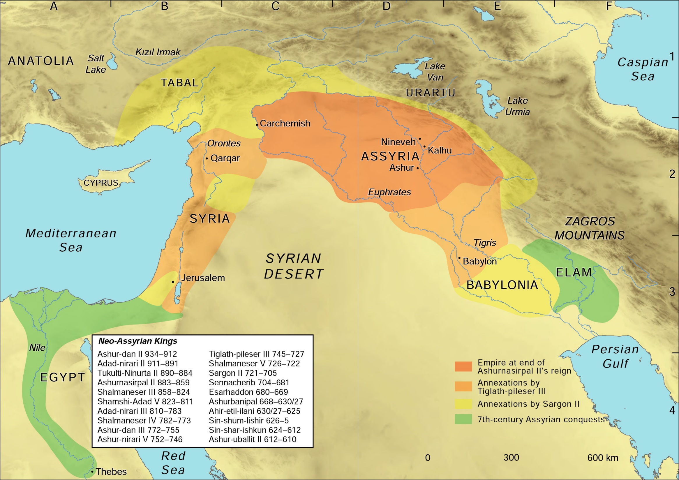
Notes:
Map: The Neo-Assyrian empire (Trevor Bryce and Jessie Birkett-Rees, Atlas of the Ancient Near East: From Prehistoric Times to the Roman Imperial Period [London: Routledge, 2016], 168-169)

Slide 18
Isaiah 30:15b: In repentance and rest is your salvation, in quietness and trust is your strength 31:1 Woe to those who go down to Egypt for help, who rely on horses, who trust in the multitude of their chariots and in the great strength of their horsemen, but do not look to the Holy One of Israel, or seek help from the Lord. 6 Return, you Israelites, to the One you have so greatly revolted against. 8 “Assyria will fall by no human sword; a sword, not of mortals, will devour them.
Notes:
以赛亚书 30：1耶和华说：“祸哉，这悖逆的儿女！他们同谋却不由于我，结盟却不由于我的灵，以致罪上加罪。 2 起身下埃及去，并没有求问我，要靠法老的力量加添自己的力量，并投在埃及的荫下。 3 所以法老的力量必做你们的羞辱，投在埃及的荫下要为你们的惭愧。 4 他们的首领已在琐安，他们的使臣到了哈内斯。 5 他们必因那不利于他们的民蒙羞，那民并非帮助，也非利益，只做羞耻凌辱。” 6 论南方牲畜的默示。 “他们把财物驮在驴驹的脊背上，将宝物驮在骆驼的肉鞍上，经过艰难困苦之地，就是公狮、母狮、蝮蛇、火焰的飞龙之地，往那不利于他们的民那里去。 7 埃及的帮助是徒然无益的，所以我称他为‘坐而不动的拉哈伯’。 责民悖逆不听训言 8 “现今你去，在他们面前将这话刻在版上，写在书上，以便传留后世，直到永永远远。 9 因为他们是悖逆的百姓、说谎的儿女，不肯听从耶和华训诲的儿女。 10 他们对先见说：‘不要望见不吉利的事！’对先知说：‘不要向我们讲正直的话！要向我们说柔和的话，言虚幻的事。 11 你们要离弃正道，偏离直路，不要在我们面前再提说以色列的圣者！’ 12 所以以色列的圣者如此说：‘因为你们藐视这训诲的话，倚赖欺压和乖僻，以此为可靠的， 13 故此，这罪孽在你们身上好像将要破裂凸出来的高墙，顷刻之间忽然坍塌。 14 要被打碎，好像把窑匠的瓦器打碎，毫不顾惜，甚至碎块中找不到一片可用以从炉内取火，从池中舀水。’” 15 主耶和华以色列的圣者曾如此说：“你们得救在乎归回安息，你们得力在乎平静安稳。”你们竟自不肯！ 16 你们却说：“不然，我们要骑马奔走。”所以你们必然奔走。又说：“我们要骑飞快的牲口。”所以追赶你们的也必飞快。 17 一人叱喝必令千人逃跑，五人叱喝你们都必逃跑，以致剩下的好像山顶的旗杆，冈上的大旗。
18 耶和华必然等候，要施恩给你们，必然兴起，好怜悯你们，因为耶和华是公平的神。凡等候他的，都是有福的！ 19 百姓必在锡安，在耶路撒冷居住，你不再哭泣。主必因你哀求的声音施恩给你，他听见的时候，就必应允你。 20 主虽然以艰难给你当饼，以困苦给你当水，你的教师却不再隐藏，你眼必看见你的教师。 21 你或向左或向右，你必听见后边有声音说：“这是正路，要行在其间。” 22 你雕刻偶像所包的银子和铸造偶像所镀的金子，你要玷污，要抛弃，好像污秽之物，对偶像说：“去吧！” 23 你将种子撒在地里，主必降雨在其上，并使地所出的粮肥美丰盛。到那时，你的牲畜必在宽阔的草场吃草。 24 耕地的牛和驴驹必吃加盐的料，这料是用木锨和杈子扬净的。 25 在大行杀戮的日子，高台倒塌的时候，各高山冈陵必有川流河涌。 26 当耶和华缠裹他百姓的损处，医治他民鞭伤的日子，月光必像日光，日光必加七倍，像七日的光一样。 耶和华怒灭仇敌俾民欢喜 27 看哪，耶和华的名从远方来，怒气烧起，密烟上腾。他的嘴唇满有愤恨，他的舌头像吞灭的火， 28 他的气如涨溢的河水，直涨到颈项，要用毁灭的筛箩筛净列国，并且在众民的口中必有使人错行的嚼环。 29 你们必唱歌，像守圣节的夜间一样；并且心中喜乐，像人吹笛，上耶和华的山，到以色列的磐石那里。 30 耶和华必使人听他威严的声音，又显他降罚的膀臂和他怒中的愤恨，并吞灭的火焰与霹雷、暴风、冰雹。 惩罚亚述 31 亚述人必因耶和华的声音惊惶，耶和华必用杖击打他。 32 耶和华必将命定的杖加在他身上，每打一下，人必击鼓弹琴。打仗的时候，耶和华必抡起手来与他交战。 33 原来陀斐特又深又宽，早已为王预备好了，其中堆的是火与许多木柴，耶和华的气如一股硫磺火，使它着起来。

Slide 19
Isaiah 19:24 In that day Israel will be the third, along with Egypt and Assyria, a blessing on the earth. 25 The Lord Almighty will bless them, saying, “Blessed be Egypt my people, Assyria my handiwork, and Israel my inheritance.”

Slide 20
Repentance and rest,
quietness and trust:
That’s where we are changing to

Slide 22
灵性低潮: 脱离
Where we are changing to
\Efforts Effectiveness | No | Yes
Yes | Accept grace | Serve gratefully
No | Accept justice | Trust with quietness

